Slide 1

CISM Certified Information Security Manager^{® An ISACA Certification}

Slide 2

About Your Instructor
Kelly Handerhan, CISM, CISA CRISC, CISSP, PMP, etc.
KellyH@Cybertrain.IT
703-568-1663

Slide 3




The Preliminaries
Start and finish
Course style
Coffee and breaks
Lunch

Slide 4
Let’s Get To Know Each Other
Your name and surname
Your organization
Your profession (title, function, job responsibilities)
Your experience with the InfoSec/IT Audit/ITSM
Your personal “Brush with Greatness”

Slide 5
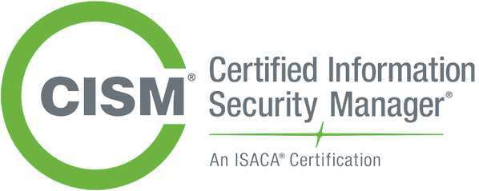
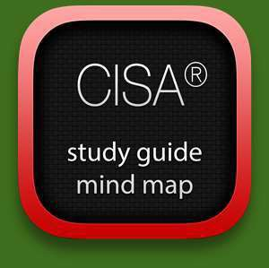
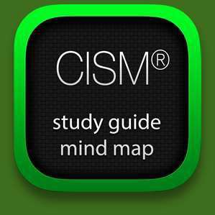
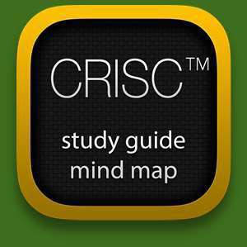
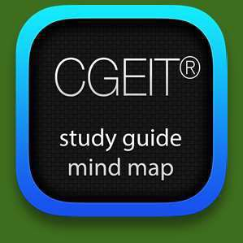
Information Systems Audit and Control Association
ISACA.org
COBIT®, CISA®, CISM®, CRISC® and CGEIT® are registered trademarks of ISACA.

Slide 6

Overview of the CISM Certification

Slide 7
Course Objectives
Introduction to CISM certification
The role of a CISM
Understanding the IT Security domains and related concepts
Presenting business value and requirements of IT Security
Understanding of ISACA RISK IT Framework structure, concepts, definitions, and processes dedicated to risk management
Main goal:
Preparing students to CISM exam
Secondary Goal:
Awareness of IT Security best practices

Slide 8
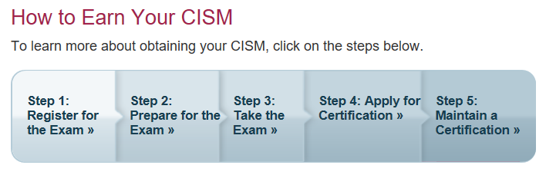
Earning Your CISM

Slide 9
CISM Domain Structure (1/2)
Domain 1
Information Security Governance
Domain 2
Information Risk Management and Compliance
Domain 3
Information Security Program Development and Management
Domain 4
Information Security Incident Management

Slide 10




CISM Domain Structure (2/2)
Domain 1 Information Security Governance
Mandates
Domain 2 Information Risk Management
and Compliance
deploys
reports to
Domain 3
Information Security Program Development and Management
requires
Domain 4 Information Security Incident
Management

Slide 11
About the CISM Exam (1/2)
The CISM certification is designed to meet the growing demand for professionals who can integrate Information Security (IS) with discrete IS control skills
The technical skills and practices the CISM certification promotes and evaluates are the building blocks of success in this growing field, and the CISM designation demonstrates proficiency in this role
The CISM certification/ designation reflects a solid achievement record in managing information security, as well as in such areas as risk analysis, risk management, security strategy, security organization etc.
Certification launched: 2003
Number of individuals certified: 23000

Slide 12
About the CISM Exam (2/2)
CISM exam questions are developed with the intent of measuring and testing practical knowledge and the application of general concepts and standards
PBE & CBE (only pencil & eraser are allowed)
4 hour exam
200 multiple choice questions designed with one best answer
No negative points
No pre-requisite for exam (only for attending to exam)

Slide 13
Earning the CISM Qualification
Candidate who pass the CISM exam are not automatically CISM-certified/ qualified and cannot use the CISM designation.
Al current requirements are present in official CISM “Application for CISM Certification” document:
www.isaca.org/cismapp
After passing the exam, the following requirements must also be met within 5 years of passing exam. You will not be certified until you
✔ Have documented the relevant work experience* in the CISM Job Practice Areas. ✔ Submit the CISM Certification Application including Application Processing Fee.

Slide 14
After You Pass…
Prior to doing so, the following requirements must be met: ✔ Pass the CISM Exam within the last 5 years. ✔ Have the relevant work experience* in the CISM Job Practice Areas. ✔ Submit the CISM Certification Application including Application Processing Fee.

Slide 15
Summary
ISACA CISM Review Manual Structure
CISM Domain Structure
About the CISM Exam
Recommended reading for CISM Exam
Earning the CISM qualification

Slide 16
Domain1 Information Security Governance

Slide 17
Domain 1 Agenda
Principles of Information Security
Corporate Governance
Understanding GRC
Information Security Strategy and Roadmap
Information Security Frameworks
Information Security Program
Project Management
Policies, Standards, Guidelines and Procedures
Roles and Responsibilities
Ethics
Summary and Review

Slide 18
Principles of Information Security

Slide 19
The Goal of Information Security
The goal of information security is to protect the organization’s assets, individuals, mission and vision
In order to achieve this, organization has to do:
Asset identification
Classification of data/information and systems according to criticality and sensitivity
Application of appropriate controls

Slide 20
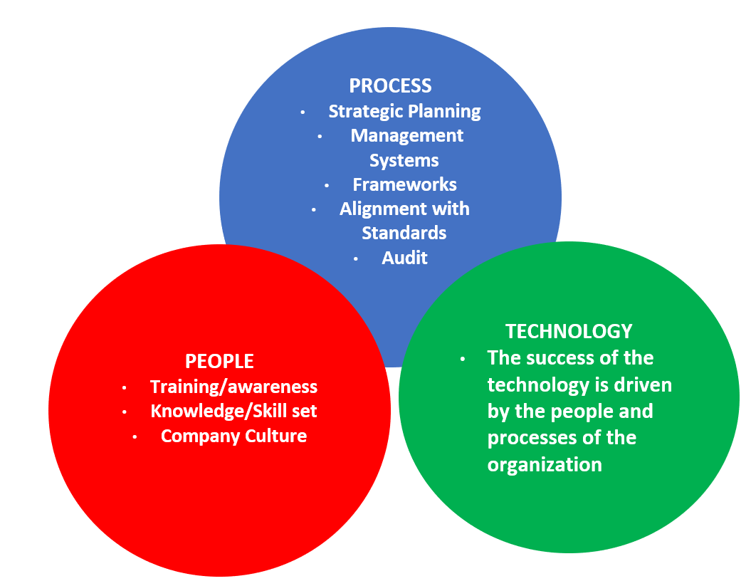
What is Security?
Notes:
A managed, risk-based approach to protecting the assets of an organization through applying controls relating to
People/Human
Processes/Organizational
Technology/Technical

Slide 21

The Information Security Triad
Integrity
Availability
Security
Performance
Confidentiality
Notes:
Threats to the CIA
Confidentiality
Social Engineering
Eavesdropping
Media Reuse
Integrity
Corruption
Malicious Modification
Availability
Unavailability--Redundancy

Slide 22
Security vs. Business
Security must be aligned with business needs and direction
Security is embedded into the business functions and acts as a internal part of business operations providing:
Strength
Resilience
Protection
Stability
Consistency
Reliability
Security must be treated, discussed, and maintained as a business issue

Slide 23
Corporate Governance
8/89 | 26/432

Slide 24
Corporate Governance
Ethical corporate behavior by directors or others charged with governance in the creation and presentation of value for al stakeholders
The distribution of rights and responsibilities among different participants in the corporation, such as board, managers, shareholders and other stakeholders
The Organization for Economic Co-operation and Development (OECD) states: “Corporate governance involves a set of relationships between a company’s management, its board, its shareholders and other stakeholders. Corporate governance also provides the structure through which the objectives of the company are set, and the means of attaining those objectives and monitoring performance are determined.”

Slide 25
Business Goals and Objectives
Corporate governance is the set of responsibilities and practices exercised by the board and executive management
Information security governance is a subset of corporate governance
Goals include:
Providing strategic vision and direction
Reaching security and business objectives
Ensure that risks are managed appropriately and proactively
Verify that the enterprise’s resources are used responsibly

Slide 26
Six Basic Outcomes of Effective Security Governance
Strategy Alignment
Risk Management
Value Delivery
Resource Management
Performance Measurement
Integration

Slide 27
Benefits of Information Security Governance
Effective information security governance can offer many benefits to an organization, including:
Compliance and protection from litigation or penalties
Cost savings through better risk management
Efficient utilization of security investments that support organization’s objectives
Reduced risks and potential business impacts to an acceptable level
Better oversight of systems and business operations
Opportunity to leverage new technologies to business advantage
Business value generated through the optimization o security investments with organizational objectives

Slide 28
Performance and Governance
Governance is only possible when metrics are in place to determine whether critical organizational objectives are achieved
Those metrics are used for
Measuring
Monitoring
Controlling
Reporting
Enterprise-wide measurements should be developed that will be consistent in all organization activities

Slide 29
Understanding GRC (Governance, Risk and Compliance)

Slide 30
What is GRC?
In response to widescale fraud and the unethical behavior of numerous organizations in the early 2000’s, the Open Compliance & Ethics Group (OCEG) provided a set of published, open source standards addressing Principled Performance through GRC
Includes standards, guidelines, tools and online resources to address governance, risk management, compliance and ethics (GRC) for global corporations and other organizations
Directs organizations to meet objectives through
Sound, principled leadership
Addressing the unknown elements of the business
Maintaining compliance with laws and ethical behavior
https://www.oceg.org
Notes:
In response to widescale fraud and the unethical behavior of numerous organizations in the early 2000’s, the Open Compliance & Ethics Group (OCEG) provided a set of published, open source standards addressing Principled Performance through GRC
Includes standards, guidelines, tools and online resources to address governance, risk management, compliance and ethics (GRC) for global corporations and other organizations
Directs organizations to meet objectives through
Sound, principled leadership
Addressing the unknown elements of the business
Maintaining compliance with laws and ethical behavior

Slide 31
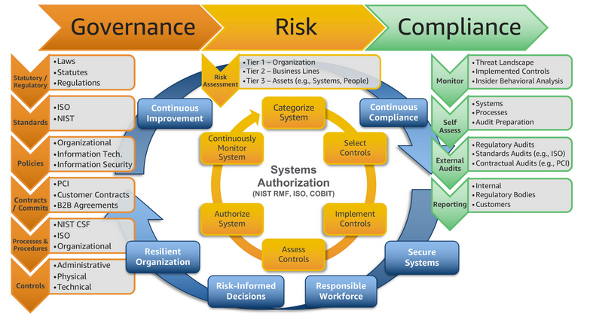

Slide 32
Governance
Corporate Governance
Providing strategic vision and direction
Reaching security and business objectives
Ensure that risks are managed appropriately and proactively
Verify that the enterprise’s resources are used responsibly
Governance answers four questions:
1.Are we doing the right things?
2.Are we doing them the right way?
3.Are we getting them done well?
4.Are we getting the benefits?
IF the answer is no to any of these questions, how do we close the gap between current state and desired state?
Notes:
Corporate governance is ethical corporate behavior by directors and/or others charged with governance in the creation of value for stakeholders. Also includes the distribution of rights and responsibilities among different participants in the corporation, such as the board, management, shareholders and other stakeholders
Security Governance is a framework allowing the security goals and objectives of an enterprise to be set and expressed by senior management, communicated throughout the organization. Governance provides entities throughout the organization with the authority to implement and enforce security, and further provides oversight and a means to verify performance
Governance: the accountability for protection of the assets of an organization
Board of directors
Applicable to all departments and includes risk management
Value creation = benefits realization, risk optimization and resource optimization

Slide 33
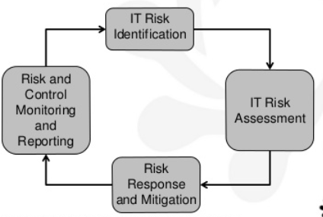
Risk

Slide 34
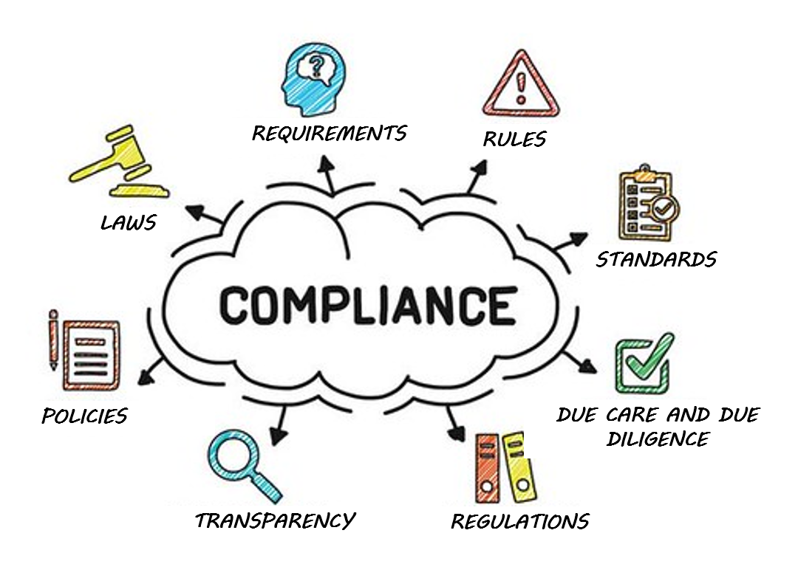
Compliance

Slide 35
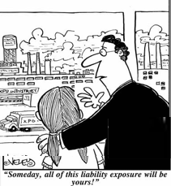
Liabilities
Who is responsible for the security within an organization?
Senior management
Are we liable in the instance of a loss?
Due Diligence
Due Care
Prudent Person Rule
Notes:
Due Care and Due Diligence
The information owner, senior management, has the responsibility of classifying data, dictating how it will be protected, and ensuring that only the necessary individuals access it. If anything happens to the data, they are ultimately responsible.
The owners are expected to practice due care. Due care means to take the necessary steps to protect assets, as in installing anti-virus or intrusion detection system (IDS) software.
Due diligence is the act of investigating and understanding the risks the company faces.
A company practices due care by developing security policies, procedures, and standards. Due care shows that a company has taken responsibility for the activities that take place within the corporation and has taken the necessary steps to help protect the company, its resources, and employees from possible risks.
Thus, due diligence is understanding the current threats and risks, and due care is implementing countermeasures to provide protection from those threats. If a company does not practice due care and due diligence pertaining to the security of its assets, it can be legally charged with negligence and held accountable for any ramifications of that negligence.
If a security incident took place and it was determined that the information owner was not practicing due care, then liability could easily lie at his doorstep.

Slide 36
The Information Security Strategy and Road Map

Slide 37
What is a Security Strategy?
“An information security and risk management (ISRM) strategy provides an organization with a road map for information and information infrastructure protection with goals and objectives that ensure capabilities provided are aligned to business goals and the organization’s risk profile.”
--The ISACA Journal 2010

Slide 38
The Desired State of Security
The desired state of security should be defined in terms of
It should be clear to all stakeholders what the intended security state is
The desired state according to COBIT
“Protecting the interests of those relying on information, and the processes, systems and communications that handle, store and deliver the information, from harm resulting from failures of availability, confidentiality and integrity”
Focuses on IT-related processes from IT governance, management and control perspectives

Slide 39
Information Security Strategy Objectives
The Information Security Strategy forms the basis for the plan(s) of action required to achieve security objectives
The long-term objectives describe the “desired state”
Should describe a well-articulated vision of the desired outcomes for a security program
Information Security Strategy objectives should be stated in terms of specific goals directly aimed at supporting business activities
Security Strategy must
Be defined
Be measurable
Provide guidance

Slide 40
Business Case Development
Included in the Business Case:
Reference
Context (business objectives/opportunities)
Value Proposition
Focus
Deliverables
Dependencies (CSFs)
Project metrics (KPIs, KGIs)
Workload
Requires resources
Commitments

Slide 41
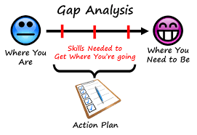
Gap Analysis

Slide 42
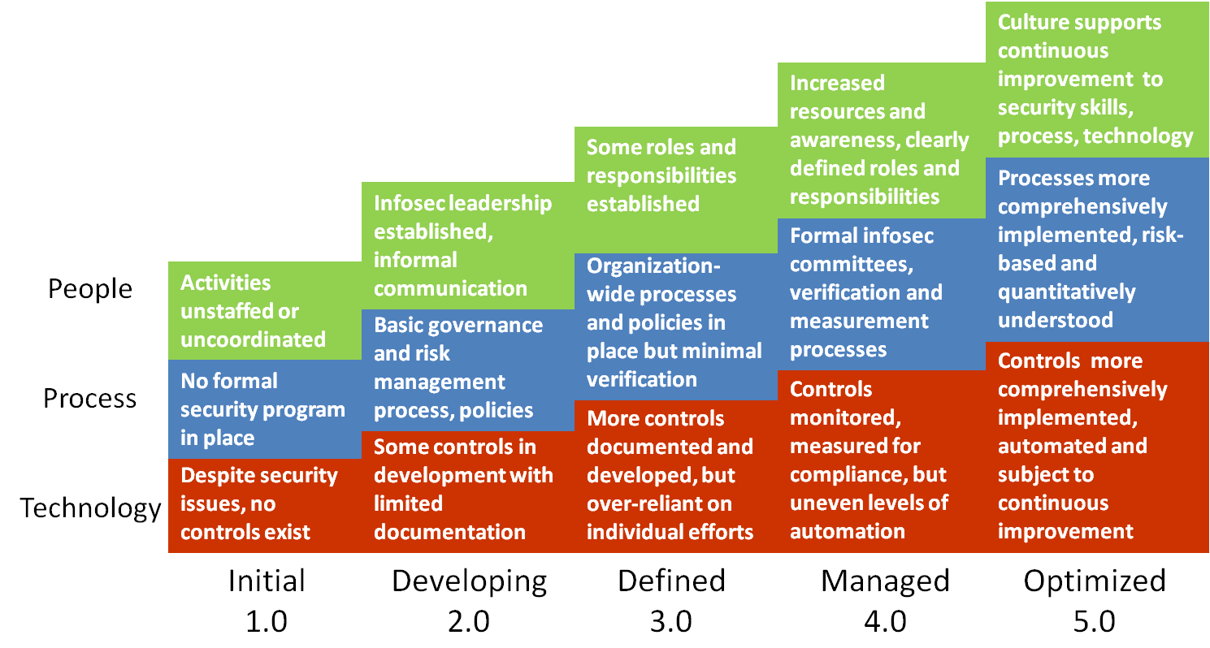
Gap Analysis using the CMMI
Repeatable
Notes:
Capability Maturity Models, such as the CMMI from Carnegie Mellon evaluate an organization on the maturity of its processes. Usually for compliance, or to meet customer requirements an organization may need to pursue a rating from 1-5 from CMMI. Gap analysis looks at the current state vs. the desired state and helps us close the gap.

Slide 43
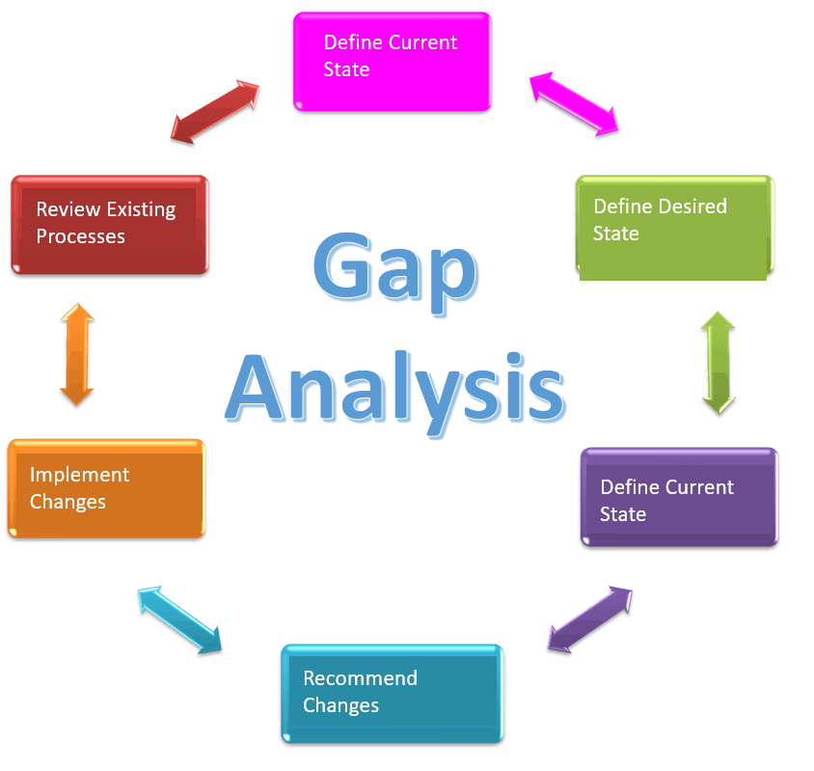
Closing the Gap: Information Security Strategy
Long term perspective to help move the organization from current state to desired state as detailed in gap analysis
Standard throughout the organization
Aligned with business strategy/direction
Understands the culture of the organization
Reflects business needs and priorities
Compare the Two
Notes:
The purpose of a strategic plan for security is to provide management with the necessary information to make informed decisions about investment in security. The strategic plan links the security function with the business direction. The strategy must present a business case that describes key business benefits and outcomes related to security, with recommended strategies for achieving those outcomes. Long term vision for the organization is the responsibility of senior management and should be understood throughout the organization. Each department or division within the enterprise should be working in alignment to achieve the desired state.

Slide 44
Elements of a Strategy
A security strategy needs to include
Resources needed
Constraints
A road map (A broad plan for achieving the organizational goals)
Includes people, processes, technologies and other resources
A security architecture: defining business drivers, resource relationships and process flows
Achieving the desired state is a long-term goal of a series of projects or program

Slide 45
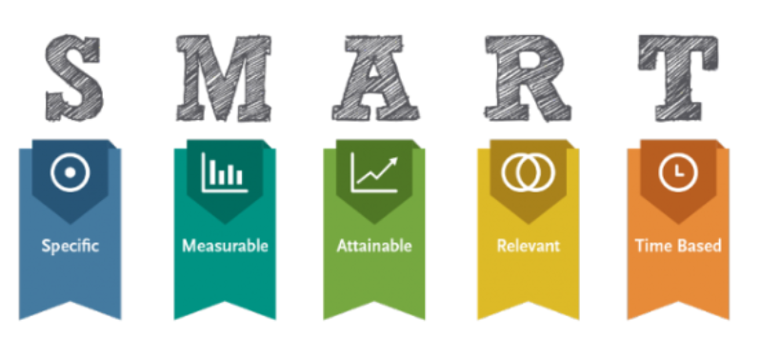
Objectives of an Information Security Strategy
Begin with an understanding of the long-term objectives of the organization. Strategy should describe a well-articulated vision of the desired outcomes for a security program through SMART objectives
Notes:
Short-term objectives help us accomplish long term goals.
Example of a security strategy objective – Protect the confidentiality of customer PII
Key initiative – Strengthen policies and standards clarifying requirements for data protection (These are usually the gaps that were found in the risk assessment.)
Enables objectives – Confidentiality of information, improved security of systems & network services, proactive data security and governance.
Description – Develop, approve, and launch a suite of information security policies, standards, and guidelines based on ISO/IEC 27001.
Key benefits – These benefits need to be aligned with the business.
Clear security baselines for all departments
Policy-based foundation to measure results
Consistent application of security controls across the enterprise
Project – listed technology, service, etc. that will meet the objective.

Slide 46
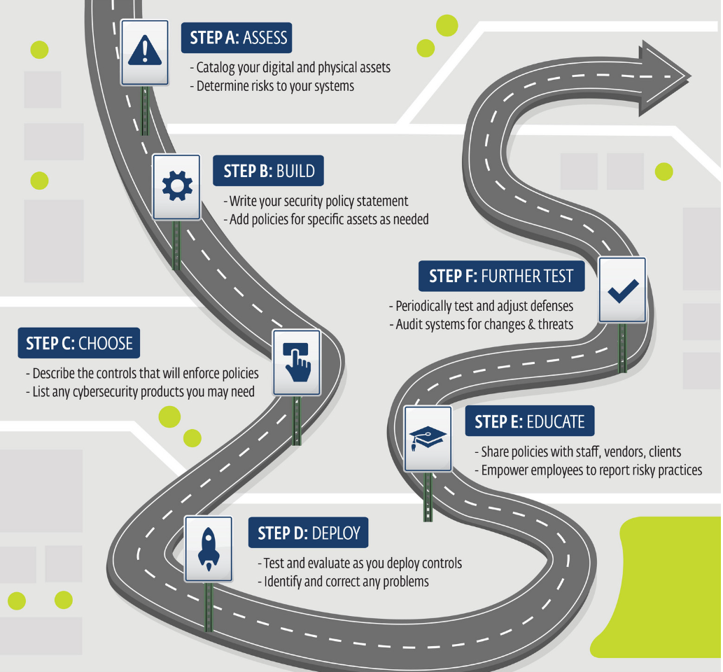
Information Security Road Map

Slide 47
Information Security Frameworks

Slide 48
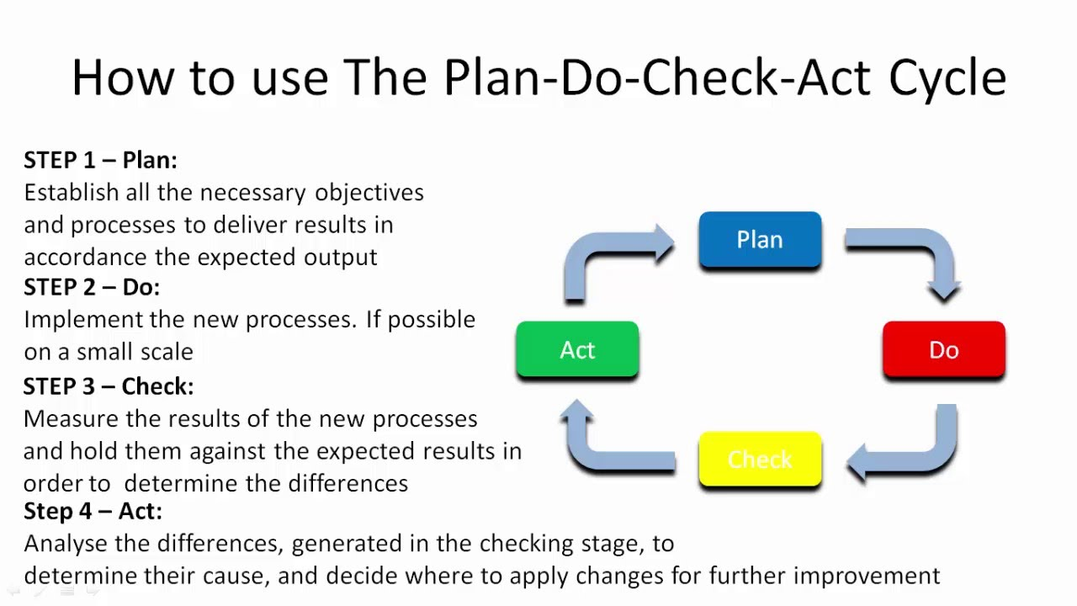
Frameworks: ISO 27001
Standard Framework for implementing and managing an ISMS based on the PDCA model
Requires senior management to
Systematically examine the organization's information security risks, taking account of the threats, vulnerabilities, and impacts;
Design and implement a coherent and comprehensive suite of information security controls and/or other forms of risk treatment (such as risk avoidance or risk transfer) to address those risks that are deemed unacceptable;
Adopt an overarching management process to ensure that the information security controls continue to meet the organization's information security needs on an ongoing basis.
Notes:
ISO 27001 is a formal standard against which organizations can be certified. ISO 27002 (and other ISO documents) provide assistance with implementation. For instance, ISO 27001 provides a management system in which information security must be planned, implemented, monitored, reviewed, and improved. It means that management has its distinct responsibilities, that objectives must be set, measured and reviewed, that internal audits must be carried out and so on. All those requirements are defined in ISO 27001. Practical implementation and further detail is provided in ISO 27002. For instance ISO 27001 may indicate that access control is essential, but one would look to ISO 27002 to understand the various ways to enforce access control. In reality the two documents are closely related, whereas ISO 27002 is one (of many) tools to accomplish ISO 27001 certification

Slide 49
ISO 27000 Standards
Which standard to use from the ISO 27000 series and when
27001: A framework designed to develop, build, implement, assess and improve an ISMS (Information Security Management System)
27002: Describes the implementation of the controls referenced in Appendix A of ISO 27001.
Specifies 15 Domains, 35 control objectives (each of which is supported by at least one control) and 114 controls
27003:2017: Provides practical guidance for the implementation of an Information Security Management System (ISMS) in an organization based on ISO/IEC 27001.
ISO/IEC 27004:2016 provides guidelines intended to assist organizations in evaluating the information security performance and the effectiveness of an information security management system in order to fulfil the requirements of ISO/IEC 27001. It establishes:
The monitoring and measurement of information security performance
the monitoring and measurement of the effectiveness of an information security management system (ISMS) including its processes and controls
The analysis and evaluation of the results of monitoring and measurement
ISO 27005: Provides guidelines for Information Security Risk Management for organizations following ISO 27001 Framework

Slide 50
ISO 27002: The 14 Domains
ISO 27001 Appendix A/ISO 27002 Controls
ISMS Structure | Physical and Environmental Security
Security Policy | Operations Security
Organization of Information Security | Communications Security
Human Resources Security | Information Systems Acquisition, Development, Maintenance
Asset Management | Supplier Relationships
Asset Control | Information Security Incident Management
Cryptography | Information Security Aspects of Business Continuity
Compliance
Notes:
Provides best practice recommendations on information security controls for use by those responsible for initiating, implementing or maintaining information security management systems (ISMS).
Information security is defined in the context of the C-I-A triad:
The preservation of confidentiality (ensuring that information is accessible only to those authorized to have access)
The preservation of integrity (safeguarding the accuracy and completeness of information and processing methods)
The preservation of availability (ensuring that authorized users have access to information and associated assets when required)

Slide 51
Other Common Frameworks
SABSA(Sherwood Applied Business Security Architecture)
TOGAF (The Open Group Architecture Framework)
COBIT (Control Objectives for Information and related Technology)
COSOERM and COSO IC
Business Model for Information Security
Six Sigma
Model originated at the Institute for Critical Information Infrastructure Protection
Publications from NIST and ISF
US Federal Information Security Management Act (FISMA)
Securing quality
ISO standards on quality (ISO 9001:2000)
Notes:
These other frameworks are not testable, but are used in numerous environments

Slide 52
Information Security Program

Slide 53
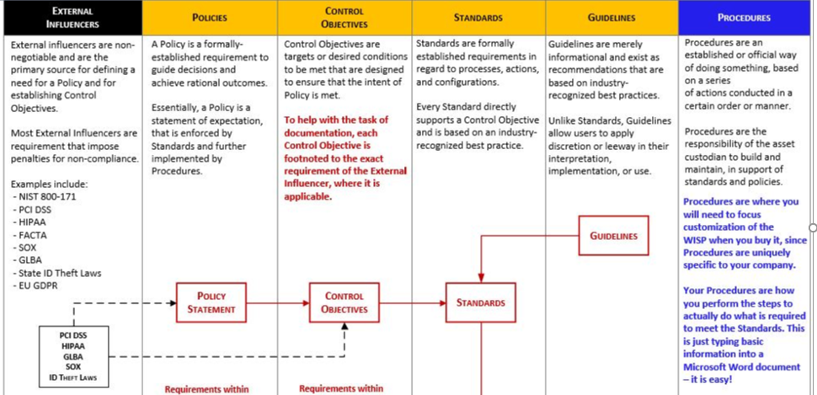
What is a Security Program?
“A security program identifies, manages and protects the organization’s assets while aligning to information security strategy and business goals, thereby supporting an effective security posture.”

Slide 54
Information Security Program
Provides the means for achieving strategy
Policies/Standards/Procedures/Guidelines
Roles and Responsibilities
SLA's Service Level Agreements/Outsourcing
Data Classification/Security
C&A (Certification and Accreditation) aka Assessment and Authorization
Auditing
Notes:
The information security program should be based on a comprehensive risk analysis. The controls that are implemented are a direct result of the risk mitigation strategy, and should provide a positive return on investment (keeping in mind that costs/benefits are not always monetary). You can think of the security program as the set of controls we implement to bring residual risk down to an acceptable level.

Slide 55
Centralization: Better Control, Better Security, Ease of Admin, More Consistency
Decentralized: Better Alignment with business objectives
SF
LA
HQ --DALLAS
Security Policy
DC
CHI
NYC
MIA

Slide 56
Project Management

Slide 57
The Importance of Project Management

Slide 58
Documents of the Project Management Lifecycle

Slide 59
Project Management: Initiating
Formalized selection and approval of the project
Documents
Business Case
Project Charter
Stakeholder Register
Identification of Stakeholders
Stakeholder Register

Slide 60
What is a Business Case?
A business case is designed to convince key stakeholders of the benefits of undertaking a particular project.
It is an essential PM Document and starting point for the project charter.
Includes a brief description of what, why, how and when the project will solve the needs of the customer
Ideally, it will identify define in easy to understand terms the need for the project in such a way that key stakeholders will have buy-in for the project

Slide 61
Project Management: Planning
Develop the approach and provide the documents to execute, monitor and close the project. These documents are consolidated into the Project Management Plan
Methodology to approach creation of Scope, Cost, Schedule, Risk, Quality baselines
Define metrics to assess process
Define the target estimates for scope, time, schedule through the development of baselines
Define processes of change management, requirements analysis, variance analysis, and other means of managing the process.

Slide 62
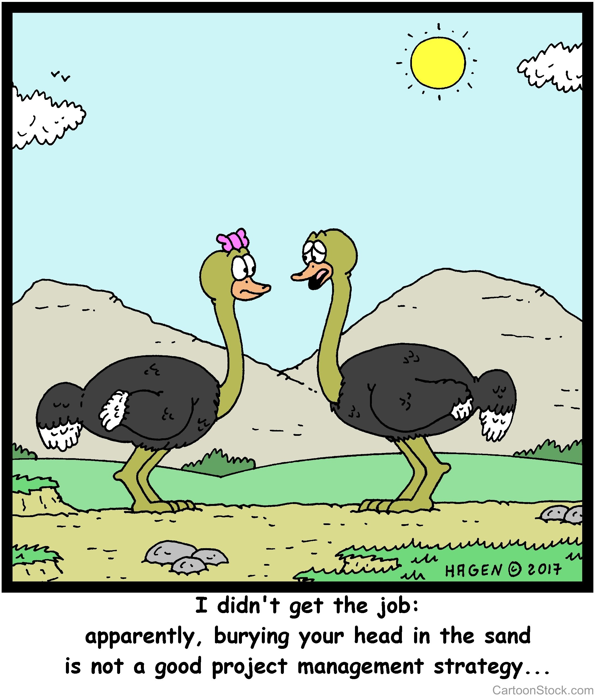
Project Management: Execution
PM directs and manages the work of the project per the Project Management Plan
Work performance data is collected
Deliverables are produced
Risks are managed based on the risk management plan
Through Quality Assurance project processes are audited
Change requests are validated

Slide 63

Project Management: Monitoring and Controlling
Examine the baselines vs. work performance data (plan vs. actual) through variance analysis
Determine if the project is meeting its objectives and make changes as necessary
Verify scope through Quality Control (Inspect the Product)
Validate deliverables through Customer Acceptance
Assess contracts and SLAs to ensure third parties providing as promised
Change requests are evaluated and approved or denied through the integrated change control process defined in the PM Plan
Provide reports and forecasts

Slide 64
Project Management: Closing
Transfer the product, service or result to the customer
Bring the project or phase to an orderly close
Close procurements according to contracts or disputes are handled accordingly
Debrief Project Team
Conduct Lessons Learned
Archive Project Files

Slide 65
Documents of the Project Management Lifecycle

Slide 66
Policies, Procedures, Standards and Guidelines

Slide 67
Types of Policy
Three main types of policies exist:
Corporate Policy
System Specific Policy
Issue Specific Policy
Notes:
The Corporate (Organizational) Security Policy can be thought of as a blueprint for the whole organization’s security program. It is the written document that indicates the organization’s approach to security and voices senior management’s commitment to support the security function. Addresses issues like the C-I-A triad, authenticity, and compliance with regulations and other drivers.
A System-specific policy is concerned with a specific or individual computer system. It is meant to present the approved software, hardware, and hardening methods for that specific system.
An Issue-specific policy is concerned with a certain functional aspect that may require more attention. For this reason, a separate policy is prepared for that issue to explain with details the required level of security, and the instructions that all staff in the organization must abide by to achieve this level.

Slide 68
System and Issue Specific Policies
System Specific Policies | Issue Specific Policies
Web Servers must be configured according to a consistent image with baseline configuration approved by Director of IT and Director of Marketing Multifactor authentication must always be used when accessing domain controllers Client systems must be validated periodically against a baseline image Etc. | Change Management Policy Acceptable Use Policy Privacy Data/System Ownership Separation of Duties (SOD) Mandatory Vacations Job rotation Least privilege Need to know Dual control M of N control
Notes:
Change Management Policy: all changes to baseline security configuration must be submitted for approval, approved, tested, documented, scheduled, implemented, monitor. NOTHING HAPPENS ON THE FLY
Acceptable Use Policy: Management's expectation for how company resources are to be used
Privacy: Privacy can be infringed upon, but employees must be notified
Data/System Ownership: Can’t always assume senior management is the owner. For instance, patients maintain ownership of their Personal Healthcare Information, even though they may share it with a doctor
Separation of Duties: Protects against a single individual having too much power, makes sure there is a clear reporting path that is unconflicted, and forces employees to collude with someone else to commit fraud
Mandatory Vacations: Frequently used in banking or other financial industries. Used as a detective control, for investigations while the employee is on a mandated leave from work.
Job Rotation: Serves as a detective control, but also provides redundancy of personnel
Least Privilege: Employees are granted the ability to perform only the actions they need to perform their jobs.
Need to Know: Employees are granted access to only the data they need to perform their work
Dual Control: Prevents abuse of power. For instance, Admin A and Admin B both must enter their passwords in order to recover private keys from archival
M on N Control is an extension of dual control, but is not dependent on specific employees being present. M and N are simply variables. Example: Any 4 out of 9 network admins must be present to recover private keys from archival

Slide 69
Data Owners: Often the LoB (Lines of Business)—Business units, COULD BE senior management, but doesn’t have to be. Determine classification and access of data. Chooses the risk response and is ultimately accountable for the protection of data. Data custodian: Is responsible for protecting and maintaining the data

Slide 70
Standards
Mandatory
Created to support policy, while providing more specifics details.
Reinforces policy and provides direction
Can be internal or external
Notes:
Whereas policies are few and broad, standards fill in the specifics. A policy may indicate that all PII data must be encrypted, and they standard defines the current encryption algorithm to be used is AES 256

Slide 71
Procedures
Mandatory
Step by step directives on how to accomplish an end-result.
Detail the “how-to” of meeting the policy, standards and guidelines

Slide 72
Guidelines
Not Mandatory
Suggestive in Nature
Recommended actions and guides to users
“Best Practices”

Slide 73
Baselines
Mandatory
Minimum acceptable security configuration for a system or process
The purpose of security classification is to determine and assign the necessary baseline configuration to protect the data
Notes:
Baselines are often implemented through the use of images. Different images are needed to support different operating systems and are used for variance control purposes, as well as to determine and control changes to systems.

Slide 74
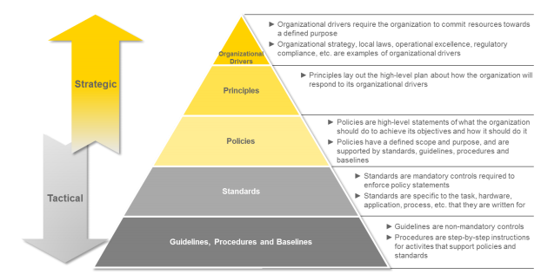
Information Security Policy Framework

Slide 75
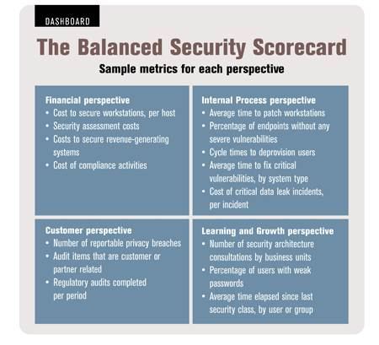
Assessing the Program with a Balanced Scorecard
The Balanced scorecard addresses 4 key areas of performance:
Financial metrics - provide information about financial performance both revenue and expenses
Customer metrics - assess the extent to which the company is meeting customer needs and expectations
Internal process measures - provide insight into the efficiency of internal processes and allow leaders to identify and correct problems
Measures of learning and growth - give managers information about employee satisfaction and development

Slide 76
Roles and Responsibilities

Slide 77
Steering Committee
Oversight of Information Security Program
Acts as Liaison between Management, Business, Information Technology, and Information Security
Assess and incorporate results of the risk assessment activity
into the decision-making process
Ensures all stakeholder interests are addressed
Oversees compliance activities

Slide 78
Senior Management’s Responsibilities
Senior Management is ultimately responsible to:
Provide oversight
Provide funding and support
Ensure testing (and that appropriate results are achieved)
Prioritize business functions
Establish a common vision/strategy/framework for the enterprise
“Sign off” on Policy, BIA and other organizational documents
Notes:
The purpose of a strategic plan for security is to provide management with the necessary information to make informed decisions about investment in security. The strategic plan links the security function with the business direction. The strategy must present a business case that describes key business benefits and outcomes related to security, with recommended strategies for achieving those outcomes. Long term vision for the organization is the responsibility of senior management and should be understood throughout the organization. Each department or division within the enterprise should be working in alignment to achieve the desired state.

Slide 79
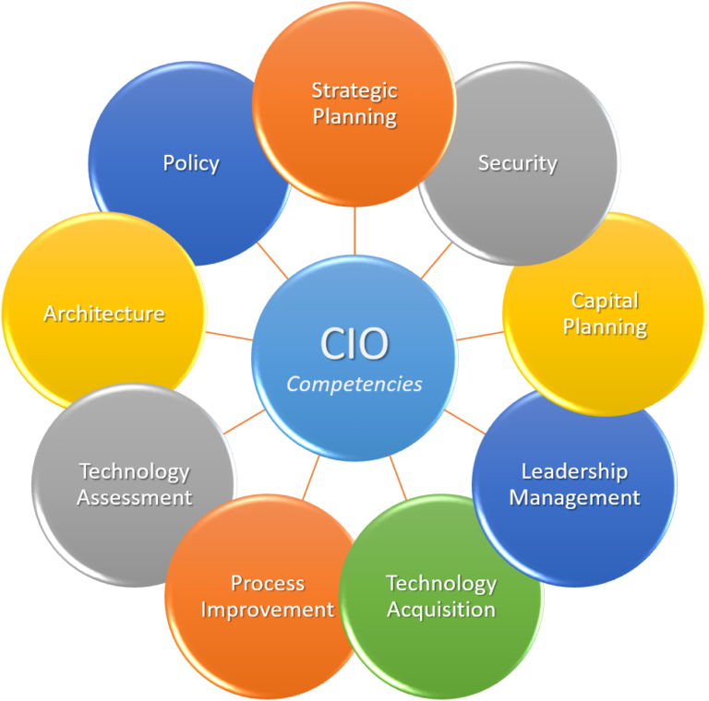
Chief Information Officer (CIO)
Strategic Planning
Policy Development
Technology Assessments
Process Improvement
Acquisitions
Capital Planning
Security
Notes:
The CISO isthe senior manager ultimately responsible for providing C-I-A for information assets.
Responsible for protecting the CIA of information through the following:
Policy
Investigation
Testing
Compliance
IT planning, budgeting, and performance, including its information security components

Slide 80
Information Security Manager
Functional Manager, responsible for achieving for determining the “how”
Play a leading role in introducing an appropriate, structured methodology
Act as major consultants in support of senior management

Slide 81
Business Managers
Responsible for business operations. The individual lines of business are our customers
Provide direction to ensure security is implemented in such a way as to meet business objectives
Responsible for security enforcement and direction
Responsible for day-to-day
Monitoring
Reporting
Disciplinary actions
Compliance
Notes:
Business managers are often our customers as we fulfil our role in information security. Remember, our ultimate purpose is to support the objectives of the business, the business managers are the ones who are closest to the business and are often owners of the systems and the data. If there is ever a conflict between InfoSec and the business function owner, the business will always be the ultimate decision makers.

Slide 82
Security Practitioners
Responsible for proper implementation of security requirements in their IT systems
Support or use the risk management process to identify and assess new potential risk and implement new security controls as needed to safeguard their IT systems

Slide 83

Auditors
Objective Evaluation of controls and policies to ensure that they are being implemented and are effective.
If internal auditing is in place, auditors should not report to the head of a business unit, but rather to the Chief Operating Officer or some other entity without direct stake in result
Auditors document and do not modify

Slide 84
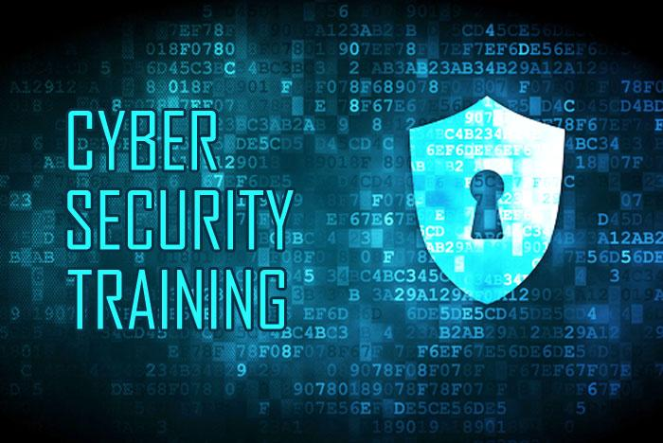
Security Trainers
Must understand the risk management process
Develop appropriate training materials
Conduct security trainings and awareness programs catered to roles within the organization
Incorporate risk assessment into training programs to educate the end users
Encourage users to report violations

Slide 85
Ethics

Slide 86
Ethical Standards
Responsibility to all stakeholders
Customers
Partners
Suppliers
Management
Owners
Employees
Community
Rules of behavior
Legal
Corporate
Industry
Personal

Slide 87
Ethics Plan of Action
Develop a corporate guide to computer ethics for the organization
Develop a computer ethics policy to supplement the computer security policy
Add information about computer ethics to the employee handbook
Find out whether the organization has a business ethics policy, and expand it to include computer ethics
Learn more about computer ethics and spread what is learned

Slide 88
ISACA Code of Ethics
Required for all certification holders
Support the implementation of, and encourage compliance with, appropriate standards, procedures and controls for information systems
Perform their duties with objectivity, due diligence and professional care, in accordance with professional standards and best practices
Serve in the interest of stakeholders in a lawful and honest manner, while maintaining high standards of conduct and character, and not engage in acts discreditable to the profession
Maintain the privacy and confidentiality of information obtained in the course of their duties unless disclosure is required by legal authority
Such information shall not be used or personal benefit or released to inappropriate parties

Slide 89
Summary and Review

Slide 90
Domain 1 Summary
Principles of Information Security
Corporate Governance
Understanding GRC
Information Security Strategy and Roadmap
Information Security Frameworks
Information Security Program
Project Management
Policies, Standards, Guidelines and Procedures
Roles and Responsibilities
Ethics

Slide 91
Review Questions
QUESTION NO: 1
Which of the following should be the FIRST step in developing an information security strategy?
A. Perform a technical vulnerabilities assessment
B. Analyze the current business strategy
C. Perform a business impact analysis
D. Assess the current levels of security awareness
Prior to assessing technical vulnerabilities or levels of security awareness, an information security
manager needs to gain an understanding of the current business strategy and direction

Slide 92
Review Questions
QUESTION NO: 2
Senior management commitment and support for information security can BEST be obtained through presentations that:
A. use illustrative examples of successful attacks.
B. explain the technical risks to the organization.
C. evaluate the organization against best security practices.
D. tie security risks to key business objectives.
Senior management seeks to understand the business justification for investing in security. This can best be accomplished by tying security to key business objectives

Slide 93
Review Questions
Question 3
Minimum standards for securing the technical infrastructure should be defined in a security:
A. strategy.
B. guidelines.
C. model.
D. architecture.
Hardware, software, firmware and the configurations of the technical environment are defined as architecture

Slide 94
Review Questions
Question 4
Which of the following are seldom changed in response to technological changes?
A. Standards
B. Procedures
C. Policies
D. Guidelines
Policies are high-level statements of objectives. Because of their high-level nature and statement of broad operating principles, they are less subject to periodic change.

Slide 95
Review Questions
QUESTION NO 5
Investments in information security technologies should be based on:
A. vulnerability assessments.
B. value analysis.
C. business climate.
D. audit recommendations.
Investments in security technologies should be based on a value analysis and a sound business case

Slide 96
Domain 2
Information Risk Management

Slide 97
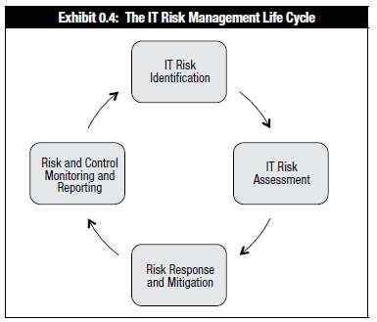
Chapter 2 Risk Management Agenda
Risk Introduction
The Risk Management Life Cycle
IT Risk Identification
IT Risk Assessment
Risk Response and Mitigation
Risk and Control Monitoring and Reporting

Slide 98
Risk Introductions

Slide 99
Essential Risk Definitions
Asset: Something of tangible or intangible value and is worth protecting
Vulnerability: A weakness in the design, implementation, operation or internal control of a process that could expose a system to adverse threats—A lack of adequate controls
Threat: Something that could pose loss to all or part of an asset
Probability: The likelihood the risk will occur
Impact: The damage caused if the risk event occurs. Sometimes referred to as severity
Threat Agent: What carries out the attack
Exploit: An instance of compromise
Risk: The combination of the probability of an event and its consequence. Risks are often seen as an adverse event that can threaten an organization’s assets or exploit vulnerabilities and cause harm. *****REMEMBER: Risks are always in the future. Once a risk has happened it is an incident

Slide 100
Additional Risk Definitions
Inherent Risk: With all business endeavors there is some degree of risk
Residual Risk: Risk that remains after a control has been implemented. Ultimately risk should be mitigated until the residual risk is within the level that management is willing to accept (management’s risk tolerance)
Secondary Risk: One risk response may cause a second risk event
Risk Appetite: Senior management’s approach to risk (Seeking, Neutral, Averse)
Risk Tolerance: The acceptable level of variation that management is willing to allow for any particular risk.
Risk Profile: An organizations current exposure to risk
Risk Threshold: A quantified limit beyond which your organization is not willing to go
Risk Capacity: Amount of risk an organization can absorb without threatening its viability
Risk Utility: The positive oucome desired from taking a risk
Controls: Proactive and Reactive mechanisms put in place to manage risks.

Slide 101
Types of Risk
Systemic Risk: Category of risk that describes threats to a system, market or economic segment. Markets with interconnected institutions and interdependent operations, such as finance, are most susceptible to systemic risk
Contagious Risk: Events that happen to several business partners in a short time frame
DYN DoS led to loss of availability to Amazon, Twitter, Google, etc.
Widespread loss of trust and confidence in the payment and settlement systems
Obscure Risk: Risk that has not yet occurred and is unlikely or difficult to fathom (Sometimes known as a black swan event)
Visibility: Be in a position that it can observe anything going wrong
Recognition: Have the capability to recognize an observed event as something wrong

Slide 102

Wait…What the Heck is That?!?

Slide 103
Risk Governance Objectives
Effective risk governance helps ensure that risk management practices are embedded in the enterprise, enabling it to secure optimal risk – adjusted return.
Risk governance has four main objectives:
Establish and maintain a common risk view.
Integrate risk management into the enterprise.
Make risk-aware business decisions.
Ensure that risk management controls are implemented and operating correctly.

Slide 104
Context of IT Risk Management
Risk Management: Coordinated activities to direct and control the enterprise with regard to risk
Understanding of the organization and its context, or environment includes:
Intent and capability of threats
Assets
Relationship of vulnerabilities
Vulnerability to changes in economic or political conditions
Changes to market trends and patterns
Emergence of new competition
Impact of new legislation
Existence of potential natural disaster
Constraints caused by legacy systems and antiquated technology
Strained labor relations and inflexible management

Slide 105
ISACA’s Risk Management Life Cycle
Cyclical process
Process based on the complete cycle of all the elements
Continuous process with refinement, adaptation and improvement and maturity

Slide 106
The Risk Management Lifecycle
Risk Identification:
Asset Value*Threat*Vulnerability
Identify and determine the value for assets
Identify Threats and Vulnerabilities
Use Risk Scenarios and Create the Risk Register
Risk Assessment (Value)
Analysis (Probability X Impact = Loss Potential)
Qualitative vs. Quantitative
Evaluation (Loss Potential vs. Cost of Countermeasure)
Risk Mitigation/Response
Reduce
Accept
Transfer
Avoid
Reject
Ongoing Controls Evaluation

Slide 107
Risk Identification

Slide 108
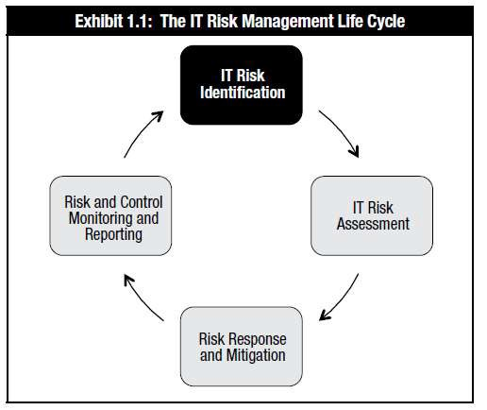
Risk Identification

Slide 109
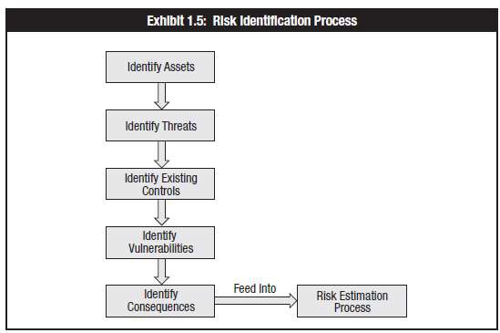
Methods to Identify Risk
Risk Assessment Process

Slide 110
Methods to Identify Risk
Sources of risk documentation
Audit reports Incident reports
Interviews with SMEs Public media
Annual reports
Press releases
Vulnerability assessments and penetration tests
Business continuity and disaster recovery plans
Interviews and workshops
Threat intelligence services

Slide 111
Risk Culture and Communication
Benefits of open communication
Risk aware business decisions
Assistance in executive management’s understanding of the actual exposure to risk
Awareness among all internal stakeholders of the importance of integrating risk management into their daily duties
Transparency to external stakeholders regarding the actual level of risk and risk management processes in use

Slide 112
Alignment with Business Goals and Objectives
The first and most important step for a CISM is to understand the business. Review organizational vision and strategy FIRST
Look beyond IT—Risk is measured by the impact the risk has on the business, not on a particular system
In order for risk to be integrated into the enterprise, senior management must be supportive and involved.
If management funds and supports the risk management processes we will have what we need to be successful
Good metrics mean that we have attainable objectives which will help us accomplish our goals
Good communication and transparency helps us make risk-aware business decisions

Slide 113
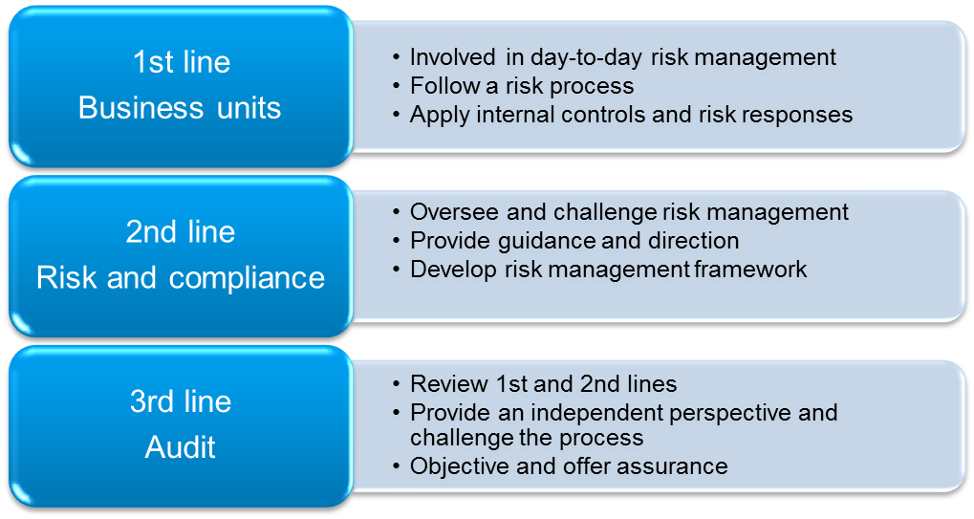
Organizational Structures and Impact on Risk
2nd line
Governance

Slide 114
Administrative Risk Controls
Segregation of duties
Job rotation
Mandatory vacations
Dual Control, M of N Control
Secure state
Principle of Least Privilege
Need to know
AUP
Data/System Ownership

Slide 115
Assets
Information
Reputation
Brand
Intellectual property
Facilities
Equipment
Cash and investments
Customer lists
Research
People
Service/business process

Slide 116
Assets
Contributing factors to calculating asset value include:
Financial penalties for legal non-compliance
Impact on business processes
Damage to reputation
Additional costs for repair/replacement
Effect on third parties and business partners
Injury to staff or other personnel
Violations of privacy
Breach of contracts
Loss of competitive advantage
Legal costs

Slide 117
Threats
Internal threats
Personnel
External threats
Natural events
Theft
Sabotage/terrorism
Criminal acts
Software errors
Mechanical failures
Accidents
Emerging threats

Slide 118
Vulnerabilities
Applications
Poorly written applications
Lack of testing
Reused Code
Personnel
Weak (or poorly enforced policies)
Susceptibility to natural disasters
Natural events
Difficulty in protecting against emerging threats

Slide 119
Risk Ownership
Ownership & accountability must be assigned to the risk owner
Risk owner determines necessary controls
Owner is determined following the identification of risk
Also responsible for control monitoring
Manager or senior official who will bear responsibility for
Determining the risk response
Monitoring effectiveness of the control
Monitoring and controlling the risk
Controls may be managed by IT, but owner is responsible for risk-related decisions

Slide 120
The IT Risk Register
Purpose: To consolidate all information about risk into a central repository
Lists all known risk
Severity, source, and potential impact
Risk owner
Current status and disposition
Information gathered by audits, vulnerability assessments, penetration tests, etc.

Slide 121
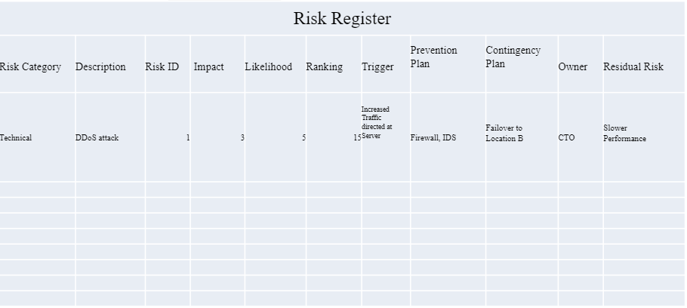
Risk Register

Slide 122
Risk Scenarios: Business-related Risk
IT risk assessment report must express risk in terms that management can understand
Use business terms
Refrain from highly technical/IT-specific terminology
Business processes and initiatives
IT risk assessment process must be aligned with the direction of the business Risk should be examined with changes to business processes
Management of IT operations
Risk depends on culture
IT management should be active in mitigating risk
Required for all certification holders
Support the implementation of, and encourage compliance with, appropriate standards, procedures and controls for information systems
Perform their duties with objectivity, due diligence and professional care, in accordance with professional standards and best practices

Slide 123
Risk Scenarios Hardware
Risk associated are:
Outdated hardware
Poorly maintained hardware Misconfigured hardware Poor architecture
Lack of documentation Lost, misplaced or stolen hardware
Hardware that is not discarded in a secure manner
Sniffing or capturing traffic Physical access
Hardware failure Unauthorized hardware
Hardware includes:
Central processing units (CPUs)
Motherboards
RAM ROM
Networking components
Firewalls and gateways
Keyboards
Monitors

Slide 124
Risk Scenarios Software
Risk associated with software includes:
Logic flaws or semantic errors
Bugs (semantic errors)
Lack of patching
Lack of access control
Disclosure of sensitive information
Improper modification of information
Loss of source code
Lack of version control
Lack of input and output validation

Slide 125
Risk Scenarios Software
Applications Risk associated:
Poor or no data validation Exposure of sensitive data Improper modification of data Logic flaws
Software bugs Lack of logs
Lack of version control Loss of source code
Weak or lack of access control
Lack of operability with other software
Back doors
Poor coding practices
Operating systems Risk associated:
Unpatched vulnerabilities
Poorly written code
Complexity Misconfiguration
Weak access controls
Lack of interoperability
Uncontrolled changes

Slide 126
Risk Scenarios Utilities
Software utilities risk associated:
Use of outdated drivers
Unavailability of drivers
Unpatched drivers
Use of insecure components
Unpatched vulnerabilities
Environmental utilities risk associated:
Power interruptions
Losses
Generators
Batteries
HVAC
Water
Secure operational area

Slide 127
Risk Network Components
Risk associated with:
Network configuration and management
Network equipment protection
The use of layered defense
Suitable levels of redundancy
Availability of bandwidth
Use of encryption for transmission of sensitive data
Encryption key management
Use of certificates to support public key infrastructure
Damage to cabling and network equipment
Tapping network connections and eavesdropping on communications
Choice of network architecture
Documentation of network architecture

Slide 128
Risk Scenarios: Network Components
Risk associated with:
Firewalls:
Packet Filters
Stateful Firewalls
Proxy Servers
Domain name system
Rogue DNS
Poisoning
Wireless access point
Rogue Access Points
Evil Twin
Routers
Switches
VLANs

Slide 129
Risk Scenarios: Data Ownership
Risk associated with:
Clear ownership of data can be a significant risk
Staff awareness of risk associated with improper data management
Review processes and policies and compliance

Slide 130
Risk Scenarios: 3rd Party Risk
Third-party Management
Data and business process ownership remains with the organization doing the outsourcing, including security requirements
Risks associated with outsourcing include:
Hiring and training practices of the supplier
Reporting and liaison between the outsourcing organization and supplier
Time to respond to any incidents
Liability for non-compliance with terms of the contract
Nondisclosure of data or business practices
Responding to requests from law enforcement
Length of contract and terms for dissolution/termination of contract
Location of data storage including backup data
Separation between data and management of data of competing firms
Outsourcing: Considered from risk/regulatory perspective
Contracts should address security and regulatory requirements
Contractual requirements
Service level agreements/Contractual requirements with customer

Slide 131
Risk Scenarios: The Cloud
Risk Associated with third-party Management
Don’t forget: LIABILITY CANNOT BE TRANSFERRED
Unauthorized access to customer and business data
Security risks at the vendor
The character of the vendor’s employees
The security of the vendor’s technology
The access the vendor has to their data
Compliance and legal risks
Where the data resides
Who is allowed to access it
How it is protected
Risks related to lack of control
Availability risks

Slide 132
Risk Assessment

Slide 133
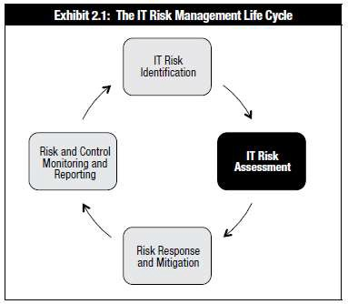
Risk Assessment

Slide 134
Risk Identification vs. Risk Assessment
Risk identification
The process of determining and documenting the risk that an enterprise faces
Documentation of assets and their values
Risk Assessment
A process used to identify and evaluate risk and its potential effects
Assessing critical functions and defining controls in place

Slide 135
Risk Assessment Methodologies
Risk analysis provides data necessary for risk response activity
Two main methods
Quantitative
Qualitative
Hybrid: Semi-quantitative

Slide 136
Qualitative Risk Assessment
Used to priorities risks
Feedback based on a range of subjective values:
Very low
Low
Moderate
High
Very high
Results usually conveyed in a table that compares likelihood with impact
Problem: Though qualitative analysis is quick and easy to perform, it does not provide hard numerical values and doesn’t fully justify the expense of controls

Slide 137
Quantitative Risk Assessment
Based on numerical calculations
Suitable for cost-benefit analysis and is the basis for justification of control selection
Can be difficult to place a quantitative value on subjective elements of risk such as customer confidence and reputation
Calculating the cost of an event
Unpredictable depending on many factors
Threat/vulnerability pairings
Be aware of relationships between threats and vulnerabilities

Slide 138
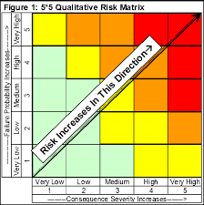
Example of Qualitative Probability and Impact Matrix

Slide 139
Quantitative Analysis Formulas and Terms
(AV) Asset Value: Dollar figure that represents what the asset is worth to the organization
(EF) Exposure Factor: The percentage of loss that is expected to result in the manifestation of a particular risk event.
(SLE) Single Loss Expectancy: Dollar figure that represents the cost of a single occurrence of a threat instance
(ARO) Annual Rate of Occurrence: How often the threat is expected to materialize
(ALE) Annual Loss Expectancy: Cost per year as a result of the threat
(TCO) Total Cost of Ownership is the total cost of implementing a safeguard. Often in addition to initial costs, there are ongoing maintenance fees as well.
(ROI) Return on Investment: Amount of money saved by implementation of a safeguard. Sometimes referred to as the value of the safeguard/control.

Slide 140
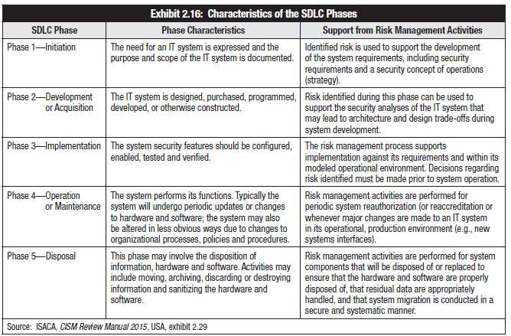
System Development Lifecycle (SDLC)

Slide 141
Business Continuity and Disaster Recovery Management
Purpose is to enable a business to continue offering critical services in the event of a disruption
Identify business processes of strategic importance
Risk assessment based on these processes
Primary responsibilities of senior management BCP/DRP solutions may differ based on scenario

Slide 142
Business Continuity Plan/Disaster Recovery Plan
Disaster recovery plan
The recovery of business and IT services following a disaster or incident within a predefined schedule and budget
Review along with the BCP to
ensure they are up to date, reflect risk scenarios and have been tested
Business continuity plan Business continuity focuses on continuing critical business
operations in the event of a crisis and having plans in place to support those operations until the business can return to normal operations
Business impact analysis Examines the impact of an outage over time

Slide 143
Essential BCP/DRP Terms
Recovery Time Objective (RTO ): Amount of time necessary to return to full operation. Can be specified for a system, a process, or an offsite facility
Acceptable Interruption Window (AIW): An Acceptable Interruption Window is the maximum time allowed for restoration, when interrupted, of critical systems or applications of an organization, so that its business goals are not negatively affected
Recovery Point Objective (RPO): Tolerance for data loss—i.e. how current data must be

Slide 144
Exception Management Practices
Cases may exist where exceptions to policies, procedures and standards are needed
Only allowed through a documented, formal process that requires approval from senior management
Should be removed when no longer needed

Slide 145
IT Risk Assessment Report
Results of risk assessment should indicate gaps between current risk state and desired state
Risk assessment report should provide management documentation of risk along with recommendations for addressing any outstanding risk issues
Justifiable and linked with results of the risk assessment
Document process used and results of the risk assessment State risk levels and priorities

Slide 146
IT Risk Assessment Report
The risk assessment report normally includes:
Objectives of the risk assessment process
Scope and description of the area subject to assessment External context and factors affecting risk
Internal factors or limitations affecting risk assessment Risk assessment criteria
Risk assessment methodology used Resources and references used
Identification of risk, threats and vulnerabilities Assumptions used in the risk assessment
Potential of unknown factors affecting assessment
Results of risk assessment Recommendations and conclusions

Slide 147
Risk Ownership and Accountability
Each risk must be linked to an owner
Makes decision on the best response to the identified risk
Owner must be at a level in the organization where they can make the necessary decision and can be accountable
Ownership with an individual is needed for accountability

Slide 148
Summary
During risk assessment, the risk practitioner has a responsibility to assess or determine the severity of each risk facing the organization.
The risk practitioner should also validate the work of the previous phase and ensure that, as much as possible, all risk is identified, assessed, documented and reported to senior management.

Slide 149
Risk Mitigation

Slide 150
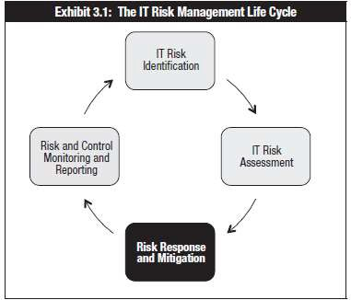
Risk Response and Mitigation

Slide 151
Aligning Risk Response with Business Objectives
Management is responsible for evaluating and responding to the recommendations included in the risk report provided following risk assessment.
Management must always be aware of the drivers for risk management, such as compliance with regulations and the need to support and align the risk response with business priorities and objectives.

Slide 152
Risk Response Options
Four options for risk response:
Risk acceptance Risk mitigation Risk avoidance Risk transfer

Slide 153
Risk Acceptance
A conscious decision made by senior management to recognize the existence of risk and knowingly decide to allow (assume) the risk to remain without (further) mitigation
Management responsible for impact of the risk event
Defined as the amount of risk that senior management has determined is within acceptable or permissible bounds
Not the same as risk ignorance, which is the failure to identify or acknowledge risk
Risk tolerance: An exception when senior management decides to exceed risk acceptance levels

Slide 154
Risk Acceptance
Examples of risk acceptance:
It is predicted that a certain project will not deliver the required business functionality by the planned delivery date. Management may decide to accept the risk and proceed with the project.
A particular risk is assessed to be extremely rare but very important (catastrophic), and approaches to reduce it are prohibitive. Management may decide to accept this risk.
Risk acceptance often based on poorly calculated risk levels
Level of risk and impact is always changing, so regular reviews are needed

Slide 155
Risk Mitigation
Risk mitigation means that action is taken to reduce the frequency and/or impact of a risk
May require the use of several controls until it reaches levels of risk acceptance or risk tolerance
Examples of risk mitigation:
Strengthening overall risk management practices, such as implementing sufficiently mature risk management processes
Deploying new technical, management or operational controls that reduce either the likelihood or the impact of an adverse event
Installing a new access control system
Implementing policies or operational procedures
Developing an effective incident response and business continuity plan (BCP)
Using compensating controls

Slide 156
Risk Avoidance
Risk avoidance means exiting the activities or conditions that give rise to risk
Applies when no other risk response is adequate
Examples of risk avoidance are:
Relocating a data center away from a region with significant natural hazards
Declining to engage in a very large project when the business case shows a notable risk of failure
Declining to engage in a project that would build on obsolete and convoluted systems because there is no acceptable degree of confidence that the project will deliver anything workable
Deciding not to use a certain technology or software package because it would prevent future expansion

Slide 157
Risk Sharing/Transfer
Risk transfer is a decision to reduce loss through sharing the risk of loss with another organization (ex., purchasing insurance)
Partnerships with another organization are an example
Decision should be reviewed on a regular basis

Slide 158
Analysis Techniques
Analysis techniques can help management to determine the best risk response Considerations for selecting a response include:
The priority of the risk as indicated in the risk assessment report
The recommended controls from the risk assessment report
Any other response alternatives that are suggested through further analysis
The cost of the various response options, including: requirements for compliance with regulations or legislation
Alignment of the response option with the strategy of the organization
Possibility of integrating the response with other organizational initiatives
Compatibility with other controls in place
Time, resources and budget available

Slide 159
Cost-Benefit Analysis
Used to justify expense associated with the control
Factors used in calculating the total cost of the control:
Cost of acquisition
Ongoing cost of maintenance
Cost to remove/replace control
Factors used in calculating benefit realized from the control:
Reduced cost of risk event
Reduced liability
Reduced insurance premiums Increased customer confidence
Increased shareholder confidence
Trust from financial backers Faster recovery
Better employee relations (safety)

Slide 160
Return on Investment
ROI is often used as a method of justifying an investment
The investment is expected to pay for itself within a set time period
Can be difficult to determine cost of control because it is hard to predict the likelihood of an attack
Return on security investment refers to ROI in relation to payback for security controls
Cost may or may not provide a direct benefit in the future, like the purchase of insurance

Slide 161
Secondary Risk
New controls present benefits as well as new risk and vulnerabilities
Example: An access control system
Pro: Protects from unauthorized access
Con: Affects normal users who forget passwords, resulting in increased denial of service and more calls for technical assistance

Slide 162
Control Design & Implementation
Controls may be proactive (safeguards) or reactive (countermeasures)
Risk assessment should determine the effectiveness of current controls to mitigate risk
In cases where current controls are not sufficient, controls must be adjusted or new controls implemented

Slide 163
Control Groups
Technical (Logical)
Firewalls
Encryption
ACLs
Physical
Door locks
Security Guard
Mantraps
Managerial (Administrative)
Policy
Directives
Standard Operating Procedures

Slide 164
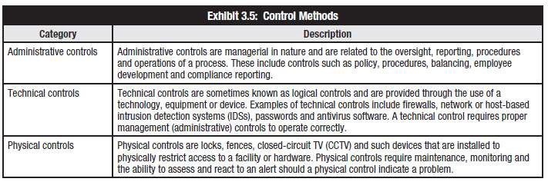
Administrative, Technical & Physical Controls

Slide 165
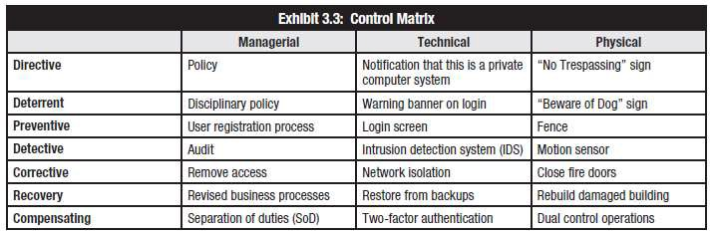
Control, Design & Implementation

Slide 166
Control Activities, Objectives, Practices, & Metrics
Reducing IT risk to acceptable risk levels requires measurement and monitoring
This phase supports the risk and control monitoring and reporting phase by putting mechanisms into place to measure risk and controls

Slide 167
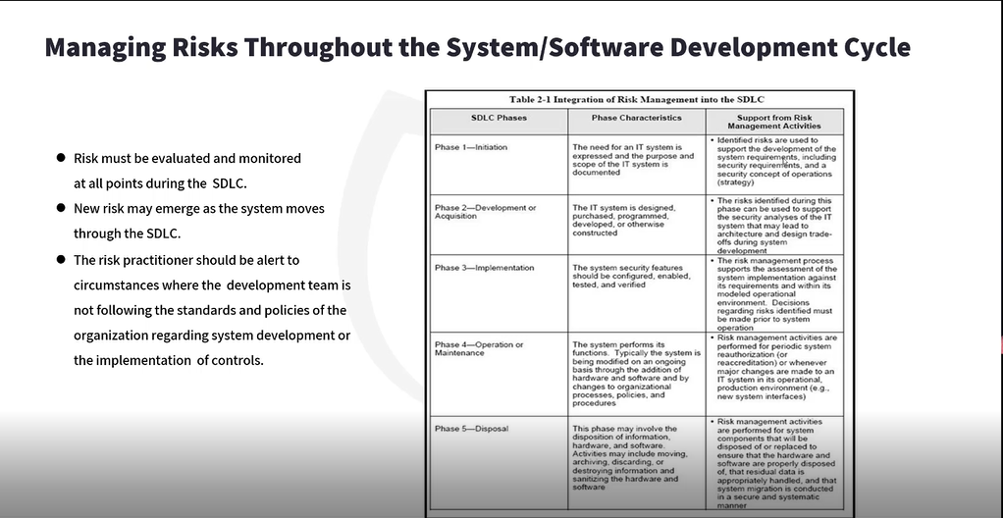

Slide 168
Risk and Control Monitoring and Reporting

Slide 169
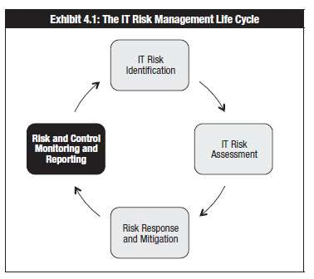
Risk and Control Monitoring and Reporting

Slide 170
Risk and Control Monitoring and Reporting
A risk response is designed and implemented based on a risk assessment that was conducted at a single point in time
Because of the changing nature of risk and associated controls, ongoing monitoring is an essential step of the risk management life cycle.
Controls can become less effective
The operational environment may change, and
New threats, technologies and vulnerabilities may emerge

Slide 171
Monitoring Controls
The purpose of control monitoring is to verify whether the control is effectively addressing the risk.
The purpose of risk monitoring is to collect, validate and evaluate goals and metrics, to monitor that processes are performing as expected, and to provide reporting.
Monitoring may be done through self-assessment or independent assurance reviews.
The risk practitioner should encourage management and process owners to positive ownership of control improvement.

Slide 172
Monitoring Controls
The steps to monitoring controls are:
Identify and confirm risk control owners and stakeholders.
Engage with stakeholders and communicate the risk and information security requirements and objectives for monitoring and reporting.
Align and continually maintain the information security
Monitoring and evaluation approach with the IT and enterprise approaches.
Establish the information security monitoring process and procedure.
Agree on a life cycle management and change control process for information security monitoring and reporting.
Request, prioritize and allocate resources for monitoring information security.

Slide 173
Results of Control Assessments
The effectiveness of control monitoring is dependent on the:
Timeliness of the reporting—Are data received in time to take corrective action?
Skill of the data analyst—Does the analyst have the skills to properly evaluate the controls?
Quality of monitoring data available—Are the monitoring data accurate and complete?
Quantity of data to be analyzed—Can the risk practitioner find the important data in the midst of all the other log data available?

Slide 174
Key Risk Indicators (KRIs)
KRIs are used by organizations to determine their risk exposure vs. risk tolerance
By measuring the risks and their potential impact on business performance, organizations can create alerts that allow monitoring, management and mitigation of key risks.
Effective KRIs help to:
Identify the biggest risks.
Quantify those risks and their impact.
Put risks into perspective by providing comparisons and benchmarks.
Enable regular risk reporting and risk monitoring.
Alert key people in advance of risks unfolding.
Help people to manage and mitigate risks.
Benefits of KRIs
Provide early warning
Provide backward-looking view on risk events
Enable documentation and analysis of trends
Provide an indication of risk appetite and tolerance
Increase the likelihood of achieving strategic objectives
Assist in optimizing risk governance

Slide 175
Key Risk Indicators (KRIs)
Examples of KRIs:
Quantity of unauthorized equipment or software detected in scans
Number of instances of SLAs exceeding thresholds
High average downtime due to operational incidents
Average time to deploy new security patches to servers
Excessive average time to research and remediate operations incidents
Number of desktops/laptops that do not have current antivirus signatures or have not run a full scan within scheduled periods
KRIs support:
Risk appetite
Risk identification
Risk mitigation
Risk culture
Risk measurement and reporting
Regulatory compliance

Slide 176
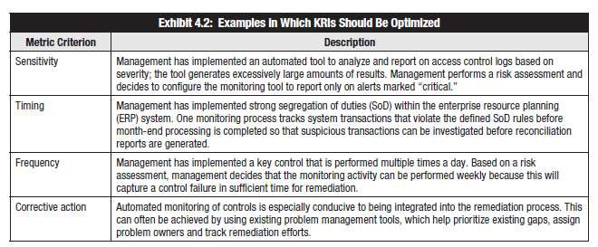
KRI Optimization

Slide 177
Data Collection and Extraction Tools & Techniques
Internal Data Sources Include:
Audit reports
Incident reports
User feedback
Observation
Interviews with management
Security reports
Logs

Slide 178
Logs
Analysis of log data should answer the following:
Are the controls operating correctly?
Is the level of risk acceptable?
Are the risk strategy and controls aligned with business strategy and priorities?
Are the controls flexible enough to meet changing threats?
Is correct risk data being provided in a timely manner?
Is the risk management effort aiding in reaching corporate objectives?
Is the awareness of risk and compliance embedded into user behaviors?
Logs may contain sensitive information and may be needed for forensic purposes
Logs should not contain too much information

Slide 179
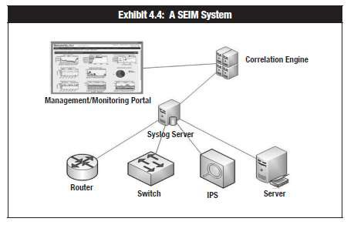
Security Event & Incident Management (SEIM)

Slide 180
External Sources of Information
External data sources can include:
Media reports
Computer emergency response team (CERT) advisories
Security company reports
Regulatory bodies
Peer organizations

Slide 181
Summary
As risk is identified and assessed, the risk owners select the appropriate response to the risk and create risk action plans to implement or modify controls selected to mitigate risk.
As controls to mitigate risk are designed and developed, the risk owner also mandates the development of the ability to monitor and report on the effectiveness of the controls.
Regular monitoring and reporting on risk is essential to management, and the use of KPIs and KRIs assists management in the monitoring of trends, compliance and issues related to risk.
Risk management is a never-ending process.
IT risk and controls should be continuously monitored and reported on to ensure continued efficiency and effectiveness.

Slide 182
Domain 3
Information Security
Program Development
and Management

Slide 183
Domain 3 Information Security Program Development and Management Agenda
Information Security Concepts
Information Security Frameworks
ISO 27001
COBIT
Information Security Architecture
Security Program Operations
Third Party Governance
Cloud Integration
IT Service Management
Control Integration
Policies, Procedures, Standards, Guidelines
Certification and Accreditation/Authorization
Metrics and Monitoring

Slide 184
Information Security Program Concepts

Slide 185
Information Security Program
As defined by ISACA the goal of this domain is to “Develop and maintain an information security program that identifies, manages and protects the organization’s assets while aligning to information security strategy and business goals, thereby supporting an effective security posture.”
Is best coordinated by the Chief Operating Officer, as this individual should properly see the need for balance between information security and business operations

Slide 186


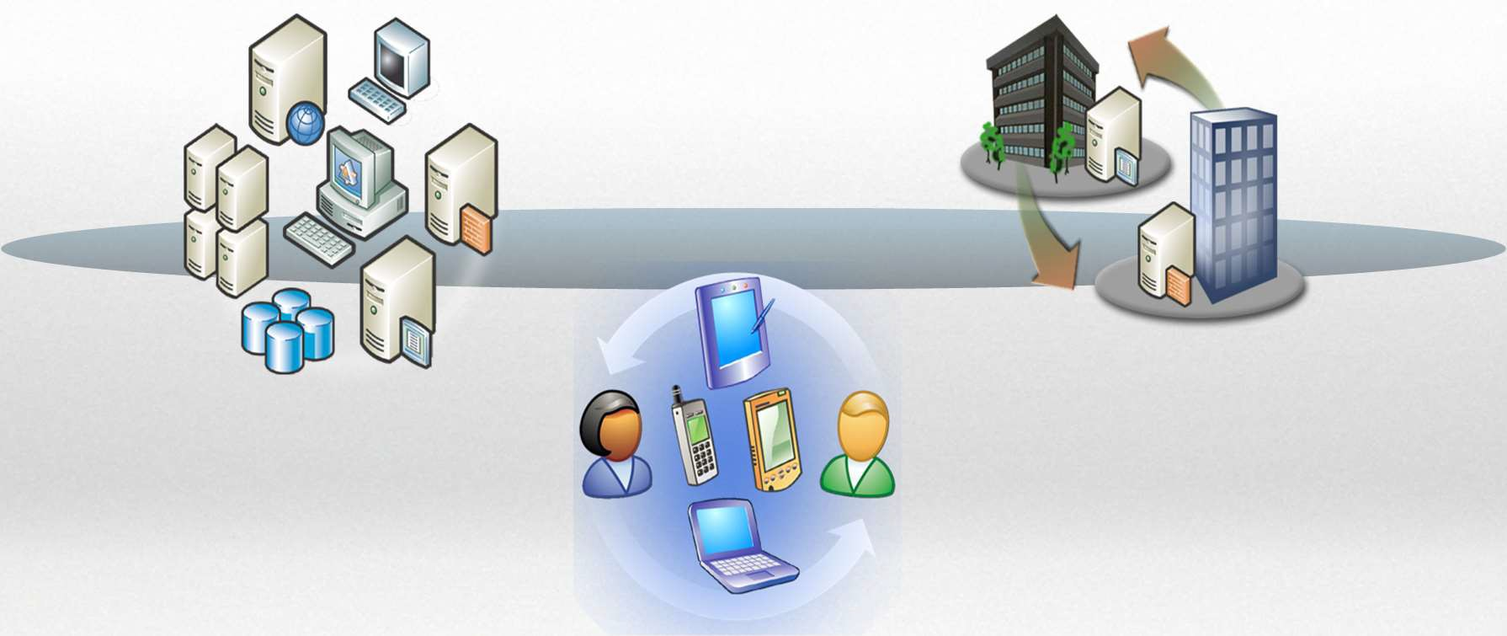
Technology
Process
People

Slide 187




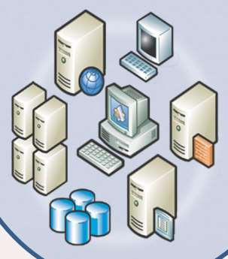
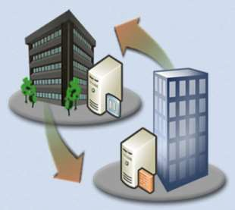



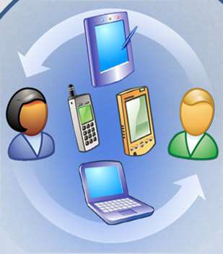
Information Security Program Elements
Technology
Training
Awareness
HR Policies
Background Checks
Roles / responsibilities
Mobile Computing
Social Engineering
Social Networking
Acceptable Use
Policies
Performance Mgt
Process
System Security
UTM. Firewalls
IDS/IPS
Data Center
Physical Security
Vulnerability Assmt
Penetration Testing
-Application Security
Secure SDLC
SIM/SIEM
Managed Services
Risk Management
Asset Management
Data Classification
Info Rights Mgt
Data Leak Prevention
Access Management
Change Management
Patch Management
Configuration Mgmt
Incident Response
Incident Management
People

Slide 188
Essential Information Security Practices
MANAGEMENT COMMITMENT
RISK MANAGEMENT
ASSET INVENTORY AND MANAGEMENT
CHANGE MANAGEMENT
INCIDENT RESPONSE AND MANAGEMENT
CONFIGURATION MANAGEMENT
TRAINING AND AWARENESS
CONTINUOUS AUDIT
METRICS AND MEASUREMENT
VULNERABILITY ASSESSMENT
PENETRATION TESTING
APPLICATION SECURITY TESTING
DEVICE MANAGEMENT
LOG MONITORING, ANALYSIS AND MANAGEMENT
SECURE DEVELOPMENT

Slide 189
Security Program Requirements
Must develop an enterprise security architecture at conceptual, logical, functional, and physical levels
Must manage risk to acceptable levels
Risk develops the Business Case that convinces mgmt. security should be performed
Must be defined in business terms to help non-technical stakeholders understand and endorse program goals
Must provide security-related feedback to business owners and stakeholders
Must address risks in relation to the five categories of assets (See next slide)

Slide 190
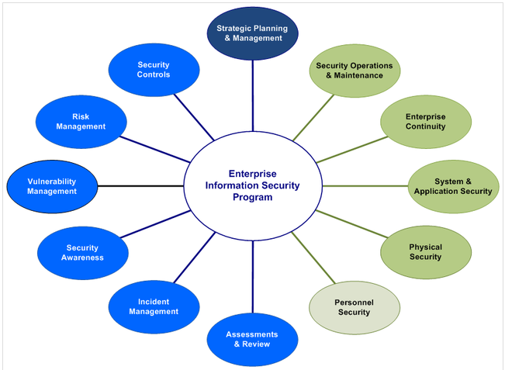
Enterprise Information Security Program

Slide 191
Information Security Program Concepts
An IS Program includes the practical elements that make the information security strategy possible.
Provides the means for closing the gap between current state and desired state
Determine Desired Outcome
Determine Desired State
Perform Gap Analysis
Develop Strategy to Close Gaps
Develop Program to Implement Strategy
Manage Security Program to Ensure Objectives are Met
Determine Current State
Risk Management Activities

Slide 192
Essential Elements of an Information Security Program
An IS Program allows the execution of a well-planned IS strategy, which is closely aligned with business goals
Management and key stakeholders must be directly involved in its development
Effective metrics must be established to determine the efficacy of the program and implemented controls

Slide 193
An Information Security Program should...
Provide Strategic Alignment with business objectives
Use risk management as the foundation for security related decisions
Deliver value to stakeholders
Manage resources efficiently and effectively
Provide integration with other assurance functions (operational security, physical security, facility security, etc.)
Use performance measurements to provide a means of measuring progress and monitoring activities

Slide 194
Information Security Frameworks

Slide 195
Security Program are Based on Frameworks
ISO 27000 Series
COBIT
COSO
TOGAF
Zachman
SABSA

Slide 196
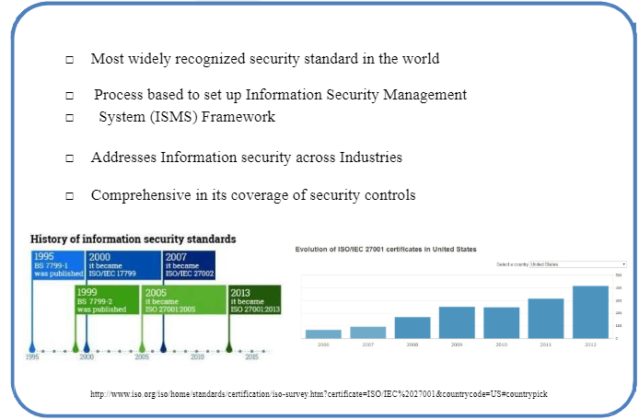
ISO 27001/27002

Slide 197
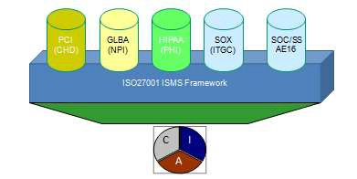
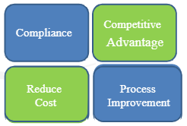
ISO 27001 Culture and Controls
ISO27001 is a culture one has to build in the organization which would help to:
Increase security awareness within the organization
Identify critical assets via the Business Risk Assessment
Provide a framework for continuous improvement
Bring confidence internally as well as to external business partners
Enhance the knowledge and importance of security-related issues at the management level
Combined framework to meet multiple client requirements/compliance requirements

Slide 198
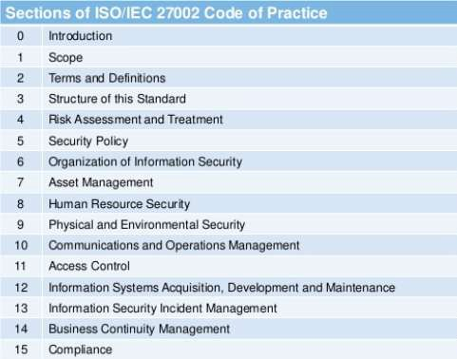
ISO 27002 Code of Practice

Slide 199

COBIT® 5
A comprehensive framework that helps enterprises to achieve their objectives for the governance and management of IT in the enterprise
Assists in maintaining a balance between benefits, risks and resource usage
Allows a holistic approach to IT governance and management to provide the greatest benefit
Allows the needs of both internal and external stakeholders to be met.
A generic framework that can benefit organizations of all size, whether commercial, not-for-profit, or public sector
5 main principles and 34 processes

Slide 200
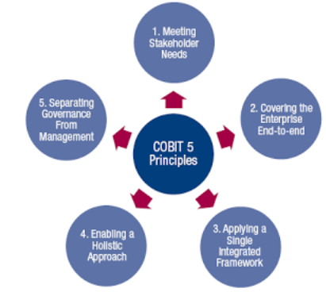
COBIT® 5 Principals
Principle 1: Meeting Stakeholder Needs
Principle 2: Covering the Enterprise End to End
Principle 3: Applying a Single Integrated Framework
Principle 4: Enabling a Holistic Approach
Principle 5: Separating Governance from Management

Slide 201
Information Security Architecture

Slide 202
Purpose of Architecture
Ensure that HW, SW, FW all fulfill a stated business objective
Components work well together
Consistency throughout the enterprise
Resources are used effectively and efficiently
Infrastructure is scalable
Existing elements can be upgraded
Additional elements can be added

Slide 203
Components of an IS Framework
Operational components
Management components
Administrative components
Educational components

Slide 204
Operational Components
Identity and access management
Security event monitoring and analysis
System patching procedures
Configuration management and change control procedures
Security metrics collection and evaluation
Maintenance of security controls and support technologies
Incident response, investigation and resolution
Secure disposal of data and storage devices

Slide 205
Management Components
Strategic between the business and Information Security
Development of policies, procedures, standards, guidelines, baselines
Ensure testing and review of incident response and business continuity plans
Ensuring roles and responsibilities are clearly defined (RACI matrix)
Periodic analysis of assets, threats, vulnerabilities and risks
Ongoing communication with business units for guidance and feedback for IS teams

Slide 206
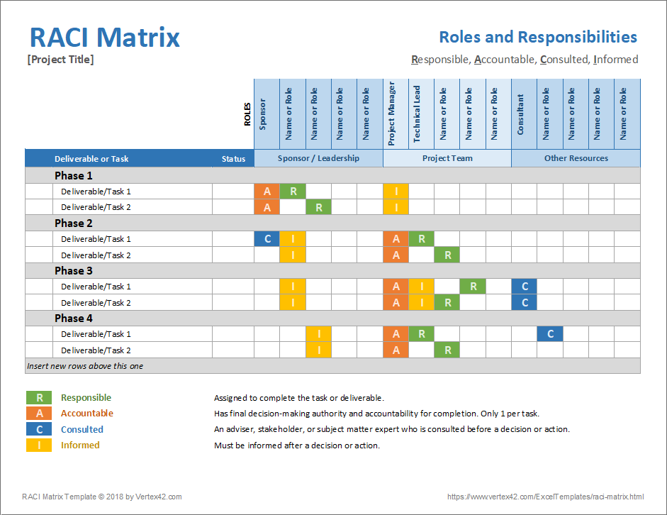
RACI Matrix

Slide 207
Administrative Components
Financial
Budgeting
TCO Analysis
ROI
HR management
On-boarding and off-boarding of employees
Performance management
Employee education and development
3rd Party Governance
Evaluation and selection criteria determination for vendors
Development and evaluation of contracts and SLA
Audit
Functional management
Balance project efforts and ongoing operational overhead with

Slide 208
Educational Components
General security training and awareness is the responsibility of HR and is often associated with employee orientation and initial new-hire training
Role-based issues and responsibilities are addressed within the business unit
Online testing can help ensure that information was understood

Slide 209
Security Program Operations

Slide 210
Security Program Operations
Event Monitoring
Vulnerability management
Secure engineering and development
Network protection
Endpoint protection and management
Identity and access management
Security incident management and BCP
Security awareness training
Managed security services providers
Data Security
Cloud Resource Management

Slide 211
Event Monitoring
Event monitoring is the practice of examining the events that are occurring on information systems, including applications, operating systems, database management systems, end-user devices, and every type and kind of network device, and being aware of what is going on throughout the entire operating environment.
Log Reviews
Honeypots
IDS/IPS
SEIM Systems
Threat Intelligence from external sources
Orchestration
Gregory, Peter H.. CISM Certified Information Security Manager All-in-One Exam Guide (Kindle Locations 7128-7130). McGraw-Hill Education. Kindle Edition.

Slide 212
Vulnerability Management
Vulnerability management is the practice of periodically examining information systems (including but not limited to operating systems, subsystems such as database management systems, applications, and network devices) for the purpose of discovering exploitable vulnerabilities, related analysis, and decisions about remediation. Organizations employ vulnerability management as a primary activity to reduce the likelihood of successful attacks on their IT environment.
Security Scan
Vulnerability Assessment
Penetration Test
Gregory, Peter H.. CISM Certified Information Security Manager All-in-One Exam Guide (Kindle Locations 7161-7165). McGraw-Hill Education. Kindle Edition.

Slide 213
Secure Engineering and Development
Security can add value at each stage of the development cycle:
Conceptual : Feasibility studies and initial risk assessments--Broad understanding of security framework
Requirements:
Functional Analysis---Customer provides the requirements of the system or product—functional requirements should include security
System Analysis—Developers determine the security specifications and plan for implementation of security checkpoints
Design: Developers plan for implementation of security per requirements. Security is provided for in budget and schedule. Design reviews will help ensure that security remains a focus
Security checkpoints are created along the way.
Engineering and development: Developers Implement determined security within the code. Unit testing ensures structure and logic of code. in the right direction.
Testing: Certification ensures the technical security features of a product meet the developer’s description. If so, the product is verified. Accreditation/Authorization is senior management’s decision to implement the product, as it solves the problem it was designed to solve. The product is now validated.

Slide 214
Secure Engineering and Development: STRIDE
Threat | Mitigation
Spoofing | Authentication
Tampering | Integrity Verification (Hashes/Message Digests/CRCs)
Repudiation | Non-Repudiation (Digital Signatures))
Information Disclosure | Confidentiality Through Encryption
Denial of Service | High Availability/Redundancy/Fault Tolerance
Escalation of Privilege | Authorization

Slide 215
Network Protection: Segmentation (1/6)
Routers: Segment the network into small networks based on broadcast traffic, security or bandwidth needs
VLANS
Firewalls: Boundary devices
Packet Filters: Screening Router—router with an ACL configured—FAST…all or nothing
Black listing: all traffic is allowed, except what’s explicit denied on a “black list”
White listing all traffic is denied, except what’s explicit allowed on a “white list”
Stateful Firewalls: Aware of the “state” of the connection—anomalies in function of protocols
Application Proxies: Understand specific applications such as web services (HTTP and HTTPS.) Content inspection
Web Proxies
Mail Proxies
DMZ
Air gaps
LAN (Trusted)
FW
Internet (untrusted)
FW
DMZ (Screened Subnet)
Semi-Trusted

Slide 216
Network Protection: Firewalls (2/6)
Firewalls: Allow/Block traffic in order to enforce network policy--based on rules called ACLs (Access Control Lists)
Usually, firewalls are placed on the perimeter of a network and allow or deny traffic based on company or network policy.
Can be hardware or software based
Static Packet Filters: Base decisions on Source/Destination IP Address and Port
Stateful inspection. Knowledge of who initiated the session. Can block unsolicited replies.
Protocol Anomaly firewalls— can block traffic based on syntax being different than the RFC would specify
Application Proxies/Kernel Proxies: Make decisions on Content, Active Directory Integration, Certificates, Time

Slide 217
Network Protection: Wireless Networks (3/6)
Encryption
WEP Wired Equivalent Privacy--WEAK
WPA—Wi-Fi Protected Access—A little better and backwards with WEP
WPA II Much Stronger, strong keys, strong algorithms
Authentication: Proof of identity
802.1x
Centralized Management: Ease of Admin, Better Security, Consistency:::RADIUS
Decentralized: Flexibility and Better alignment with business objectives—Every single access point is administered individually
LAN
AP1
AP2
AP
AP3
RADIUS (Remote Access)
Active Directory runs on Domain Controller
Wi-Fi Client
AP4
VPN Client
VPN
VPN
VPN
Dial-Up Client
RAS

Slide 218
Network Protection: Services (4/6)
DNS—uses records and cache to provide name resolution
Pharming—modification of records
Cache Poisoning—modification of cache
DNSSec—uses keys to authenticate other DNS Servers
DHCP---Automatic assignment of IP addresses
Discover—broadcast to learn who is DHCP Service
Offer—All DHCP servers respond and offer an IP address
Request—Client requests an IP from the FIRST server who offered an IP address
Acknowledge—DHCP Server grants the client the IP address removes the IP address from its scope
LDAP—Lightweight Directory Access Protocol—Authentication Servers (Domain Controllers)
Web Services—very susceptible to cross-site scripting, DoS
Mail Services—very susceptible to DoS and Confidentiality Breaches

Slide 219
Network Protection: Inspection and Detection (5/6)
Sniffers: Capture Packets on the network
IDS/IPS
Honeypots/Honeynets
Log reviews
Internal audit
External audit

Slide 220
Network Protection: NAC (Network Access Control) (6/6)
Verifies Health of System
Relies on Client-side and Server-side software
Uses a SHV (System Health Validator) on server
Client presents a Certificate of Health
Can provide Denial of access, quarantine or redirection to a remediation network

Slide 221
NAT (Network Address Translation)
10.0.0.1
10.0.0.2
Router
(Network Address Translation)
LAN
63.17.85.1
Internet
10.0.0.3
10.0.0.100
Private Internal IP Addresses 10.0.0.0
172.16.0.0-172.31.0.0
192.168.1.0

Slide 222
Endpoint Protection (Desktops, Laptops, Tablets, etc.)
Hardening systems includes:
Remove unnecessary services
Patch systems
Rename guest and administrative accounts
Review default settings and configurations
Install anti-malware and monitoring software
Images are often used to deploys baseline O/S and applications
Configuration management requires changes to be controlled and documented
Remote access tools are often used by the network team to provide assistance and remote admin if needed
Many devices have remote destruction capabilities in case of loss or compromise
Data should be encrypted for the sake of privacy
VDI relies on highly controlled servers running the apps users work with. Client systems work as terminals or thin clients

Slide 223
Data Security
Confidentiality:
Data at Rest: Encryption
Data in Motion: Secure Transport Protocols➔ SSL/TLS, SSH, IPSec
Data in Use: Homomorphic Encryption
Integrity
Hashes/Message Digests
Availability
Redundancy
Non-Repudiation
Digital Signatures---Hash (integrity) encrypted with the sender’s private key (authenticity)
Data traversing unsecured networks can have end-to-end security through the use of VPNs

Slide 224
Identity and Access Management
Identity Proofing
Account Provisioning
User Identifies—username or account number
User Authenticates--multifactor
User is Authorized—assigned rights and permissions—Best implemented through RBAC, or Role-based Access Control
User is Audited/Accountable
Account is Deprovisioned

Slide 225
Auditing
Ensures security controls are in place and are performing as expected
Can be internal or external
Five Components:
Objective
Scope
Approach
Constraints
Result

Slide 226
Third Party Governance

Slide 227
Third-Party Providers
Internet service providers, call centers, data processing centers, etc.
Vicarious liability imposes legal responsibility on an entity when the entity had nothing to do with actually causing the injury.
Often applied through “Respondent Superior” when a superior is liable for the actions of his or her employees
Laws are evolving.
Is an ISP responsible for what it’s customers do?
Is a software service that provides P2P sharing liable when its customers use that software to violate copyright restrictions?

Slide 228
Procurement Documents
Request for Information (RFI)
Request for Quote (RFQ)
Request for Proposal (RFP)
Invitation for Bid (IFB)
Contracts
MOAs
SLAs

Slide 229
Service Level Agreements
Usually a legally binding contract that offers guarantees usually centering on performance and reliability of procured systems, as well as response times from the vendor.
Could also be used internally from department to department
A form of risk transference
Metrics should be clearly defined in the SLA
Usually offer some sort of financial compensation if the metrics are not met

Slide 230
Contracts
Legally binding agreement between parties
Should be in writing and modified in writing
Five elements necessary for a contract to be legally binding:
Competency/Capacity
Consideration
Offer
Legal
Acknowledgement
Breaches are violations of contract
Damages are often awarded in response to a breach of contract

Slide 231
Cloud Integration

Slide 232
Cloud Computing NIST SP 800-145
“Cloud computing is a model for enabling ubiquitous, convenient on-demand network access to a shared pool of configurable computing resources (e.g., networks, server, storage, applications, and services) that can be rapidly provisioned and released with minimal management effort or service provider interaction.”
--NIST Definition of Cloud Computing

Slide 233
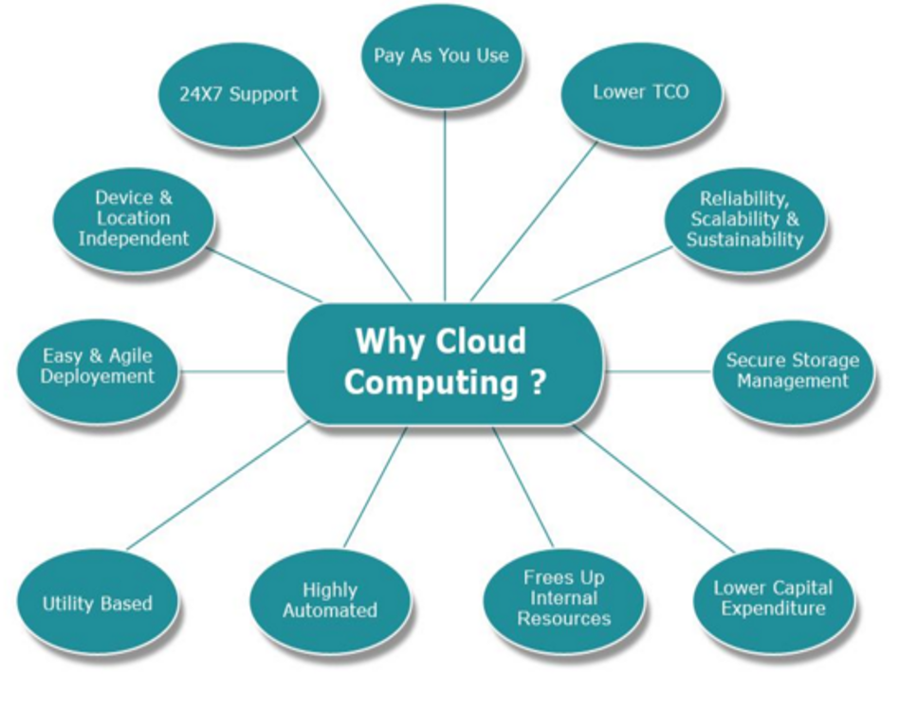
Cloud Drivers
Scalability
Mobility
Elasticity
Cost-Savings
Risk Transference/Reduction
Reduced Infrastructure
Less Overhead
Pay as you go
Shifting Capital Expenditure to Operational Expenditure
Allows company to match capacity to need, as well as pay as they go (monthly) for only the services that they use

Slide 234
Security Risks
Distributed
Laws vary from jurisdiction to jurisdiction
Multitenant
Shared physical resources make incident response, forensics, destruction, etc difficult
Responsibility cannot be transferred
Customer is still legally liable for protection of the resource—DATA OWNER MAINTAINS RESPONSIBLE IN ALL CLOUD MODELS
Privacy
The degree of privacy enforcement must be specified in SLA
CSA may have higher requirements than the enterprise

Slide 235
Deployment Models
Public
Private
Hybrid
Community

Slide 236

Cloud Service Models
SaaS
Paas
Iaas
Software

Slide 237

SaaS
Software as a Services provides the consumer the ability to use the provider’s applications running on a cloud infrastructure. The applications are accessible from various client devices through an interface like a web browser or a program interface

Slide 238

PaaS
Platform as a Service: provides the customer the capability to deploy onto the cloud infrastructure consumer-created or acquired applications created using programming languages, libraries, services and tools supported by the provider.
Server scripting environment
Management system database
Server software
Technical support
Storage
Network Access
Design and development tools
Hosting

Slide 239

IaaS
The capability provided is to provision processing, storage, networks and other fundamental computing resources where the consumer is able to deploy and run software including applications and operating systems. The consumer doesn’t control the infrastructure, but does control the OS, storage, deployed apps and configuration settings.
CPU
Memory
Disk storage local or SAN
operating
Switches, all or part of the VLAN

Slide 240
IT Service Management

Slide 241
IT Service Management 1/2
IT service management (ITSM) is the set of activities that ensures the delivery of IT services is efficient and effective, through active management and the continuous improvement of processes.
Service desk: Provides a single point of contact for customers—can be a collection point services like incident, configuration, change management and others
Incident management: ITIL defines an incident this way: “An unplanned interruption to an IT Service or reduction in the quality of an IT service.”
Problem management: Multiple incidents which seem to have a similar root cause are considered a “problem”
Change management: Ensures that proposed changes to the IT environment have a formal process for consideration. (Request, review, approve, implement, verify, post-change review)
Emergency change management should have a formal process when a change is urgently necessary
Configuration management: Configuration management (CM) is the process of recording and maintaining the configuration of IT systems. Each configuration setting is as configuration item (CI). CIs usually include
Release management: The part of the SDLC where changes in application are made available to end-users
Gregory, Peter H.. CISM Certified Information Security Manager All-in-One Exam Guide (Kindle Locations 8297-8306). McGraw-Hill Education. Kindle Edition.

Slide 242
IT Service Management 2/2
Service-level management: The set of activities that verfifies whether IS operations is the objectives for service to its customers--achieved through continuous monitoring, as well as periodic reviews of IT service delivery.
Financial management: Budgeting, capital investment, expense management, project accounting and project return on investment (ROI)
Capacity management: Addresses scalability and the ability to meet customer needs
Service continuity management: Ensures capability of IT Services to continue in the event of a disaster or catastrophe
Availability management: Provides high availability to critical resources through redundancy, resiliency and fault tolerance
Asset Management: Asset management is the collection of activities used to manage the inventory, classification, use, and disposal of assets.

Slide 243
Policies, Procedures, Standards and Guidelines

Slide 244
Policies
A set of policies are principles, formulated or adopted by an organization to reach its strategic goals and typically published in a booklet or other form that is widely accessible. Policies are designed to influence and determine all major decisions and actions, and all activities take place within the boundaries set by them.
Three main types of policies exist:
The Corporate (Organizational) Security Policy can be thought of as a blueprint for the whole organization’s security program. It is the strategic plan for implementing security in the organization.
A System-specific policy is concerned with a specific or individual computer system. It is meant to present the approved software, hardware, and hardening methods for that specific system.
An Issue-specific policy is concerned with a certain functional aspect that may require more attention. For this reason, a separate policy is prepared for that issue to explain with details the required level of security, and the instructions that all staff in the organization must abide by to achieve this level.
http://www.businessdictionary.com/definition/policies-and-procedures.html

Slide 245
Standards
Mandatory
Created to support policy, while providing more specifics details.
Reinforces policy and provides direction
Can be internal or external

Slide 246
Procedures
Mandatory
Step by step directives on how to accomplish an end-result.
Detail the “how-to” of meeting the policy, standards and guidelines

Slide 247
Guidelines
Not Mandatory
Suggestive in Nature
Recommended actions and guides to users
“Best Practices”

Slide 248
Baselines
Mandatory
Minimum acceptable security configuration for a system or process
The purpose of security classification is to determine and assign the necessary baseline configuration to protect the data

Slide 249
Policies, Procedures, Standards
Policy Objective: Describes ‘what’ needs to be accomplished
Policy Control: Technique to meet objectives
Procedure: Outlines ‘how’ the Policy will be accomplished
Standard: Specific rule, metric or boundary that implements policy
Example 1:
Policy: Computer systems are not to be exposed to illegal,
inappropriate, or dangerous software
Policy Control Standard: Allowed software is defined to include ...
Policy Control Procedure: A description of how to load a computer with required software.
Example 2:
Policy: Access to confidential information is controlled
Policy Control Standard: Confidential information SHALL never be emailed without being encrypted
Policy Guideline: Confidential info SHOULD not be written to a
memory stick
Discussion: Are these effective controls by themselves?

Slide 250
Certification and Accreditation

Slide 251
Certification and Accreditation
Certification is the technical evaluation of the product’s security mechanisms in a particular environment. Once having passed the certification process, the system is now verified
Accreditation: A formal declaration by an AO Authorizing Official (Title that has replaced Designated Accrediting Authority--DAA) that information systems are approved to operate at an acceptable level of risk based on the implementation of an approved set of technical, managerial, and procedural safeguards. Once accredited, the system is now validated.

Slide 252

Traditional Evaluation Criteria

Slide 253

Common Criteria ISO 15408
Protection Profile: Requirements from Agency or Customer
Target of evaluation: System Designed by Vendor
Security target Documentation describing how ToE meets Protection Profile
Evaluation Assurance Level (EAL 1-7) Describes the level to which ToE meets Protection Profile

Slide 254
Common Criteria Evaluation Assurance Levels
EAL 1 – Functionally tested
EAL 2 – Structurally tested
EAL 3 – Methodically tested and checked
EAL 4 – Methodically designed, tested, and reviewed
EAL 5 – Semi formally designed and tested
EAL 6 – Semi-formally verified designed and tested
EAL 7 – Formally verified designed and tested

Slide 255
Certification & Accreditation
Certification:
A process that ensures systems and major applications adhere to formal and established security requirements that are well documented and authorized.
It is usually performed by QA or someone with technical expertise
Accreditation/Authorization:
A formal declaration by an AO Authorizing Official (Title that has replaced Designated Accrediting Authority--DAA) that information systems are approved to operate at an acceptable level of risk based on the implementation of an approved set of technical, managerial, and procedural safeguards.

Slide 256
Monitoring and Metrics

Slide 257
Metrics and Monitoring
A metric is a measurement of a process or entity based on its performance in relation to desired objectives
Utilizing metrics properly requires collecting these measurements and examining them in the context of the overall information security program
Monitoring is the continuous or regular evaluation of a system or control to determine its operation or effectiveness. Can be quantitative or qualitative

Slide 258


Monitoring Function: Metrics
Strategic Metrics:
Project Plan
Budget Metrics
Risk performance
Disaster Recovery Test results Audit results
Regulatory compliance results
Strategic Metrics
Operational Metrics:
Vulnerability Scan results Server configuration
Standards compliance
IDS monitoring results Firewall log analysis Patch management status
Metrics
Tactical Metrics:
Policy compliance
Exceptions to policy/standards
Changes in process
Incident management
Tactical Metrics
Operational Metrics

Slide 259
Domain 3 Information Security Program Development and Management Review
Information Security Concepts
Information Security Frameworks
ISO 27001
COBIT
Information Security Architecture
Security Program Operations
Third Party Governance
Cloud Integration
IT Service Management
Control Integration
Policies, Procedures, Standards, Guidelines
Certification and Accreditation/Authorization
Metrics and Monitoring

Slide 260
Review Questions

Slide 261
Review Question 1
When contracting with an outsourcer to provide security administration, the MOST important contractual element is the:
A. right-to-terminate clause.
B. limitations of liability.
C. service level agreement (SLA)
D. financial penalties clause.
Service level agreements (SLAs) provide metrics to which outsourcing firms can be held accountable. This is more important than a limitation on the outsourcing firm's liability, a right-to terminate clause or a hold- harmless agreement which involves liabilities to third parties.

Slide 262
Review Question 2
On which of the following should a firewall be placed?
A. Web server
B. Intrusion detection system (IDS) server
C. Screened subnet
D. Domain boundary
A firewall should be placed on a (security) domain boundary. Placing it on a web server or screened subnet, which is a demilitarized zone (DMZ), does not provide any protection. Since firewalls should be installed on hardened servers with minimal services enabled, it is inappropriate to have the firewall and the intrusion detection system (IDS) on the same physical device.

Slide 263
Review Question 3
When a proposed system change violates an existing security standard, the conflict would be BEST resolved by:
A. calculating the residual risk
B. enforcing the security standard.
C. redesigning the system change.
D. implementing mitigating controls.
Decisions regarding security should always weigh the potential loss from a risk against the existing controls. Each situation is unique; therefore, it is not advisable to always decide in favor of enforcing a standard. Redesigning the proposed change might not always be the best option because it might not meet the business needs. Implementing additional controls might be an option, but this would be done after the residual risk is known.

Slide 264
Review Question 4
An information security program should be sponsored by:
A. infrastructure management.
B. the corporate audit department.
C. key business process owners
D. information security management.
The information security program should ideally be sponsored by business managers, as represented by key business process owners. Infrastructure management is not sufficiently independent and lacks the necessary knowledge regarding specific business requirements. A corporate audit department is not in as good a position to fully understand how an information security program needs to meet the needs of the business. Audit independence and objectivity will be lost, impeding traditional audit functions. Information security implements and executes the program. Although it should promote it at all levels, it cannot sponsor the effort due to insufficient operational knowledge and lack of proper authority.

Slide 265
Review Question 5
Which of the following is MOST effective in preventing weaknesses from being introduced into existing production systems?
A. Patch management
B. Change management
C. Security baselines
D. Virus detection
Change management controls the process of introducing changes to systems. This is often the point at which a weakness will be introduced. Patch management involves the correction of software weaknesses and would necessarily follow change management procedures. Security baselines provide minimum recommended settings and do not prevent introduction of control weaknesses. Virus detection is an effective tool but primarily focuses on malicious code from external sources, and only for those applications that are online.

Slide 266
Domain 4
Information Security
Incident Management

Slide 267
Domain 4 Information Security Incident Management: Agenda
The goal of this domain is to develop and prepare the ability to plan, respond and recover from disruptive events affecting our information assets
Making the Case for Incident Response Planning
Incident Management Process Flow
Developing the Incident Response Plan
Incident Response Devices
BCP Concepts
BCP Frameworks
Business Continuity Processes
BCP Sub-Plans
BCP Roles and Responsibilities

Slide 268
Making the Case for Incident Response Planning

Slide 269
Security Incident Response Definitions
Event: a Change in state
Incident: An event or events that have a negative impact on the company and its security
Incident Handling: Involves all the processes associated with addressing events and incidents.
Incident Response; The last step of incident management, encompassing planning, coordination and appropriate mitigation, containment and recovery strategies

Slide 270
The Importance of Incident Response Planning
Occurrences are increasing
Losses are escalating
Increase in vulnerable and misconfigured systems
Legal and regulatory groups may require
Growing sophistication of attackers

Slide 271
Outcomes of Incident Response Planning
Impact on the business will be minimized
Effective plans are in place and understood by stakeholders
Incidents are identified and contained, as well as identification of root causes, enabling recovery within the AIW (Acceptable Interruption Window)

Slide 272
Responsibilities of the CISM for Incident Response
The CISM is responsible for
Development of Incident management policy:
Set expectations
Maintain the consistency and reliability of services
Provide documentation for roles and responsibilities
Set requirements for identified alternatives for important functions
Development of incident management and response plans
Handling and coordinating incident response activities
Verifying, validating and reporting of countermeasures
Planning, budgeting and program development for all matters related to IS incident management

Slide 273
Incident Management and Response Teams
Emergency action team: designated evacuation and safety team
Damage assessment team: Qualified team who assesses the extent of the damage to physical assets and determines salvage capability of resources and assets
Emergency management team: Coordinates the actions of other recovery teams and makes key decisions when necessary
Relocation team: Responsible for coordination of process of moving to offsite facility, and back to the restored facility or facility of permanence
Security team: Often called the CIRT responsible for monitoring the system and communication links, containing security threats, resolving issues that impede recovery

Slide 274
Incident Management Process Flow
CMU/SEI “Defining Incident Management Processes” ISACA CISM Study Guide 2015, p. 231

Slide 275

Incident Management
Prepare
Protect
Respond
Triage
Detect

Slide 276
Prepare
Defines the preparation work that has to be completed prior to having any capability to respond to incidents:
Coordinate planning and design
Identify incident management requirements
Obtain funding and sponsorship
Develop Implementation Plan
Coordinate implementation
Develop Policies, processes and plans
Establish Incident handling criteria
Define Criticality
Evaluate Incident management capability
Define post-mortem review
Define process change procedure

Slide 277
Protect
Protect and secure critical data, services, processes, resources when responding to incidents
Also includes a proactive plan for improvement on a predetermined schedule
Implement changes to mitigate/limit the scope of the incident
Implement infrastructure protection improvements as indicated from post-mortem reviews or other process improvement reviews
Conduct proactive reviews and assessments of existing infrastructure

Slide 278
Detect
Identify unusual/suspicious activity that might compromise critical business functions or infrastructure
Proactive detection—conduct detective monitoring regularly Honeypots
Scan for unauthorized servers or hosts Analyze network traffic
Review audit logs and files
Reactive detection is essential as well to be able to quickly detect and attack Intrusion detection
Review audit logs and files

Slide 279
Triage
Helps direct response to areas of highest criticality through the following sub-processes
Categorization: Uses pre-defined criteria to determine and label the type of incident
Correlation: Determine/report other relevant information
Prioritization: enables minimization of impact to the most critical business function
Assignment: to the Incident Response Team (can also be referred to as the IMT—Incident Management Team)

Slide 280
Respond
Steps taken to address, contain, resolve or mitigate an incident
Technical response Collect data Analyze incident
Research corresponding technical mitigation techniques Isolate affected systems
Deploy patches and workaround
Management Response: Activities that require supervisory or mgmt. intervention— notification, interaction, escalation or approval—business and senior managers
Legal response—Activity that relates to the investigation, prosecution, liability copyright and privacy issues

Slide 281
Developing the Incident Response Plan
University of California, “Responding to Computer Security Incidents”
ISACA CISM Study Guide 2015 p. 234

Slide 282
Assessing Current Incident Response Capability
Survey
Self Assess
External Assessment
Evaluate Threats
Natural
Technical
Man-made
Evaluate Vulnerabilities
Technology
People
Processes
Controls
Incident History
Current State vs. Desired State

Slide 283
Elements of an Incident Response Plan
Preparation
Lessons Learned
Identification
Triage
Containment
Eradication

Slide 284
Preparation
Develop an incident response prior to an incident
Develop Approach/Methodology
Establish policy
Develop deterrence strategies
Determine criteria on when to report an incident to law enforcement
Ensure necessary tools are available

Slide 285
Identification
Verify an actual incident has occurred (violation analysis)
Assign ownership
Establish chain of custody
Determine severity of incident and escalate as necessary

Slide 286
Containment
Once the incident has been identified and verified, the Incident Response Plan, aka Incident Management Plan is to be activated
Notify IRT
Notify affected stakeholders
Obtain agreement of any actions taken that would affect availability of services
Obtain and preserve evidence
Document actions from this point forward
Control and manage communications to the public

Slide 287
Eradication
Determine the root cause of the incident and eliminate it
Determine signs and causes
Remove root cause
Improve defenses by implementing proactive techniques
Perform vulnerability analysis to determine additional weaknesses

Slide 288
Recovery
Restore affected systems or services to a condition specified by the Service Delivery Objectives or BCP
Restore to normal operations
Validate actions taken were successful
Involve system owners in testing
Facilitate system owners to declare operations have been restored to normal

Slide 289
Lessons Learned
At the end of incident response processes, team is de-briefed and report must be developed to share what has happened
Document the report
Analyze issues which occurred during incident responses
Propose improvement
Present reports to stakeholders

Slide 290
Incident Detection Devices

Slide 291

Protocol Analyzers (Sniffers) and Intrusion Detection Systems

Slide 292
A
B
Switch
C
D
SNIFFER
Promiscuous Mode
Port Span/Mirror
Sniffer + Analysis Engine
=
Intrusion Detection System

Slide 293
Sniffers, Intrusion Detection, Intrusion Prevention
A
C
E
SWITCH
SWITCH
F
B
D
G
PORTSPAN:
ALL TRAFFIC IS MIRRORED OUT OF THE ADMIN PORT
SNIFFER (PROMISCUOUIS MODE)
+
ROUTER
ANALYSIS ENGINE
=
IDS/IPS

Slide 294

Intrusion Detection Systems
Software is used to monitor a network segment or an individual computer
Used to detect attacks and other malicious activity
Dynamic in nature The two main types:
Host-based based (local host only)
Network-based (packet sniffer + analysis engine)

Slide 295
Types of IDS
Network-based IDS
Monitors traffic on a network segment
Computer or network appliance with NIC in promiscuous mode Sensors communicate with a central management console
Most appropriate placement for an IDS is in the DMZ
Host-based IDS (WRAPPERS)
Small agent programs that reside on individual computer
Detects suspicious activity on one system, not a network segment

Slide 296
Analysis Engine Methods
Pattern Matching
Rule-Based Intrusion Detection
Signature-Based Intrusion Detection
Knowledge-Based Intrusion Detection
Profile Comparison
Statistical-Based Intrusion Detection
Anomaly-Based Intrusion Detection
Behavior-Based Intrusion Detection

Slide 297
IDS vs. IPS
IDS: Passive:
Page or email administrator
Log event
IPS: Active
Send reset packets to the attacker’s connections
Change a firewall or router ACL to block an IP address or range
Re-configure router or firewall to block protocol being used for attack

Slide 298
IDS Issues
May not be able to process all packets on large networks
Missed packets may contain actual attacks
IDS vendors are moving more and more to hardware-based systems
Cannot analyze encrypted data
Switch-based networks make it harder to pick up all packets
A lot of false alarms
Not an answer to all prayers
Firewalls, anti-virus software, policies, and other security controls are still important

Slide 299
Business Continuity

Slide 300


Slide 301
Business Continuity and Disaster Recovery Planning
Concepts
Frameworks
NIST 800-34

Slide 302
BCP Concepts
University of California, “Responding to Computer Security Incidents”
ISACA CISM Study Guide 2015 p. 234

Slide 303
BCP vs. DRP: Concepts
Business Continuity Planning: Focuses on sustaining operations and protecting the viability of the business following a disaster, until normal business conditions can be restored. The BCP is an “umbrella” term that includes many other plans including the DRP. Long Term focused
Disaster Recovery Planning: goal is to minimize the effects of a disaster and to take the necessary steps to ensure that the resources, personnel and business processes are able to resume operations in a timely manner. Deals with the immediate aftermath of the disaster, and is often IT focused. Short Term focused
Notes:
Often these terms are used interchangeably in the field, however they are distinctly different. The BCP is a large scale plan geared towards sustaining the organization after a disaster. The BCP looks at all the business processes within an organization and provides information on how to restore operations for each process.
The Disaster Recovery Plan, on the other hand, is simply one of eight sub-plans of the BCP and is usually IT focused.

Slide 304

BCP Relationship to Risk Management
Notes:
In Domain 1, Information Security and Risk Management, we looked at Risk Management. Risk Management deals with Identifying, Assessing, Analyzing and Mitigating risks to a level acceptable by management. Notice, the definition says nothing about eliminating risks, because it’s simply not possible. In most cases, the best we can do is to mitigate them. With risk mitigation, we are lessening the probability and/or impact of a risk event. However, as you’ll remember, the amount of risk that’s left after a risk response is called residual risk. Business Continuity Planning and Disaster Recovery Planning are all about what to do when our mitigation strategies fail, or with that residual risk

Slide 305
Categories of Disruptions
Non-disaster: Device malfunction or short-term disruption of service
Emergency: Imminent threat to life or property
Disaster: Building is unusable for a day or longer
Catastrophe : Building is destroyed

Slide 306
BCP Frameworks
University of California, “Responding to Computer Security Incidents”
ISACA CISM Study Guide 2015 p. 234

Slide 307
BCP Frameworks
Standards help solve issues of inconsistency in terms, definitions and documents (within the organization)
The following institutes will provide guidance on BCP/DRP:
DRII (Disaster Recovery Institute International)
NIST 800-34 rev 1
ISO 27031
BCI GPG (Business Continuity International Good Practice Guidelines)
ISC2.org Four Processes of Business Continuity
Notes:
ISO/IEC 27031:2011 describes the concepts and principles of information and communication technology (ICT) readiness for business continuity, and provides a framework of methods and processes to identify and specify all aspects (such as performance criteria, design, and implementation) for improving an organization's ICT readiness to ensure business continuity. It applies to any organization (private, governmental, and non-governmental, irrespective of size) developing its ICT readiness for business continuity program (IRBC), and requiring its ICT services/infrastructures to be ready to support business operations in the event of emerging events and incidents, and related disruptions, that could affect continuity (including security) of critical business functions. It also enables an organization to measure performance parameters that correlate to its IRBC in a consistent and recognized manner.
The scope of ISO/IEC 27031:2011 encompasses all events and incidents (including security related) that could have an impact on ICT infrastructure and systems. It includes and extends the practices of information security incident handling and management and ICT readiness planning and services.
While this proposed standard is in draft mode, there are many internationally recognized standards
in existence, but they do not seem to line up exactly, thus causing confusion among practitioners.
Even in the US government sector, terminology is not always consistent. For example, FEMA
standard documentation refers to the BCM field as COOP, but in NIST documentation SP800-34,
COOP is seen as a subset of BCP (Business Continuity Planning). Unfortunately, in my opinion, there
is very little “common knowledge” in the BC/DR field.

Slide 308
7 Phases of Business Continuity Plan NIST SP 800-34 Revision 1
BCP Policy
Business Impact Analysis
ID Preventative Controls
Develop on IS Contingency Plan
Create Contingency Strategies
Testing, Training and Exercises
Maintenance
Notes:
Phases of Plan:
Project Initiation
Business Impact Analysis
Recovery Strategy
Plan Design and Development
Implementation
Testing
Maintenance

Slide 309

NIST SP 800-34 revision 1

Slide 310
Business Continuity Planning Processes
University of California, “Responding to Computer Security Incidents”
ISACA CISM Study Guide 2015 p. 234

Slide 311
Business Continuity Planning Processes
Project scope and planning
Business impact assessment
Continuity planning
Approval and implementation

Slide 312
Step 1: Project Scope and Planning
Acquire BCP Policy Statement from Senior Management
Business Organization Analysis: Structured analysis of the business organizational assets. FIRST
BCP Team Creation, including Project Manager. Should be cross-functional team, including representation of senior management
An assessment of the resources available and commitment to support the BCP Process from Senior Management
An analysis of the legal and regulatory landscape that governs an organization’s response to a catastrophic event

Slide 313
Step 1: Project Initiation
Must have BCP Policy and commitment of support from SENIOR MANAGEMENT
Representatives from each of the organization’s departments responsible for the core services performed by the business
Representatives from the key support departments identified by the organizational analysis
IT representatives with technical expertise in areas covered by the BCP
Security representatives with knowledge of the BCP process
Legal representatives familiar with corporate legal, regulatory, and contractual responsibilities
Representatives from senior management

Slide 314
Step 1: Project Scope and Planning: Legal and Regulatory Compliance
Senior management has the ultimate legal responsibility. They may be:
Held responsible and liable under various laws and regulations
Sued by their stockholders if not managing with due diligence and due care
Sued by employees or families in the event of injury or loss of life

Slide 315



BCP Regulatory Examples

Slide 316
Step 2: Business Impact Assessment
Risk Identification
Internal vs. 3rd Party
Probability and Impact
Categorizes processes/resources based on criticality
Defines quantitative metrics to assist with prioritizing recovery focus
BIA will help prioritize recovery priorities

Slide 317
Step 2: Business Impact Assessment: Identify Priorities
Identifies and prioritizes all business processes/resources based on criticality
Create an in-depth list of business processes and their impact on the organization if UNAVAILABLE
Often delegated to individual departments for accuracy and buy-in
Criticality is driven by the amount of loss the organization will suffer if the resource is unavailable
MTD/MTO: Maximum Tolerable Downtime/Outage: Longest time the function can be inoperable before causing a loss to senior management that is unacceptable
RTO Recovery Time Objective: This is the amount of time in which you think you can feasibly recover the function in the event of a disruption (must be less than MTD)
RPO Recovery Point Objective: Tolerance for data loss

Slide 318

Goals of the BIA

Slide 319

Step 2: Business Impact Assessment: Risk Associated with Procurements and the Cloud
Evaluate CSP’s business continuity plan--Examine SLA
Verify controls in place to meet obligations in person or through independent audit made available as SOCs (Service Organizational Controls)

Slide 320
Step 3: Continuity Planning: Strategy Development
Examines the BIA for metrics and maps controls to meet the objectives
Determine appropriate responses:
Reduce
Assign/Transfer
Accept
Reject
Some risks will have to be accepted (based on cost/benefit) while other require a more active strategy

Slide 321
Step 3: Continuity Planning: Provisions and Processes
BCP designs the specific procedures necessary to mitigate the risks to a level that is acceptable to senior management.
Three assets :
People—first priority always
Buildings/Facilities
Hardening Provisions—mitigating harm to facility
Alternate sites
Mirrored
Leased sites
Cold
Warm
Hot
Infrastructure
Redundancy of Critical Systems and Services
Recovery strategies
Failover/Failback

Slide 322
Step 4: Plan Approval and Implementation
Plan Approval
If possible, CEO should endorse plan
Otherwise another senior officer
Indicates dedication of the business to the process of business continuity planning
Plan Implementation
Create Implementation guide/schedule
Deploy resources
Supervise maintenance of plan
Train and Educate Employees
Distribute plan on need to know basis
Everyone should get at least an overview

Slide 323
Disaster Recovery

Slide 324
Phases of a Disaster
Declaration: Communicate the state of the disaster to employees based on pre-defined criteria and means.
Recovery: Focus is on the immediacy of the disaster. Human life comes first. Next, the restoration of critical business services per the BIA, beginning with MOST critical services first
Reconstitution: Return to a state of full operations at the permanent facility. Restore operations beginning with LEAST critical

Slide 325

Disaster Recovery
Strategy development: Examines the BIA for metrics and maps controls to meet the objectives
Current State →Gap Analysis→ Desired State
Provisions and processes
People—first priority always
Buildings/Facilities
Infrastructure
Plan testing and approval
Checklist
Structured Walkthrough/Tabletop
Simulation
Parallel
Full Interruption
Plan implementation
Training and education

Slide 326
BCP Roles and Responsibilities
University of California, “Responding to Computer Security Incidents”
ISACA CISM Study Guide 2015 p. 234

Slide 327
Roles and Responsibilities
Senior Executive Management
Consistent support and final approval of plans
Setting the business continuity policy
Prioritizing critical business functions
Allocating sufficient resources and personnel
Providing oversight for and approving the BCP
Directing and reviewing test results
Ensuring maintenance of a current plan

Slide 328
Roles and Responsibilities
Senior Functional Management
Develop and document maintenance and testing strategy
Identify and prioritize mission-critical systems
Monitor progress of plan development and execution
Ensure periodic tests
Create the various teams necessary to execute the plans
Notes:
Roles and Responsibilities

Slide 329
Roles and Responsibilities
BCP Steering Committee
Conduct the BIA
Coordinate with department representatives
Should include:
Business units
Senior management
IT department
Security department
Communications department
Legal department

Slide 330
Disaster Recovery Teams
Teams:
Rescue: Responsible for dealing with the immediacy of disaster—employee evacuation, “crashing” the server room, etc.
Recovery: Responsible for getting the alternate facility up and running and restoring the most critical services first.
Salvage: Responsible for the return of operations to the original or permanent facility (reconstitution)
Notes:
Roles for executing the plans

Slide 331
Developing the Teams
Management should appoint members
Each member must understand the goals of the plan and be familiar with the department they are responsible for
Agreed upon prior to the event:
Who will talk to the media, customers, share holders
Who will setup alternative communication methods
Who will setup the offsite facility
Established agreements with off-site facilities should be in place
Who will work on the primary facility
Notes:
Developing a Recovery Team
Once it is decided that these plans are needed, senior management must appoint specific people to perform the necessary tasks. Knowing the actual tasks of the job will help management ensure that they appoint the right people to the team. The team must then work with the management staff to develop the ultimate goals of the plan, identify the critical parts of the business that must be dealt with first during a disaster, and determine the priorities and tasks of departments. Once these directives are handed
down from management, the team now has goals, objectives, and priorities with which to shape the program. The team must focus on each threat and how that threat can affect the issues deemed most important by management. They develop procedures and tasks that must be performed in each situation and assign responsibility to different employees in charge of the different tasks. The more time that is given to this step in the process, the more likely the team will produce a very useful, effective, and complete plan.
The team may need to contact outside vendors to establish offsite solutions, redundant communication methods, data backup services, and redundant hardware. All agreements must be documented and outlined so that there is less confusion in a time of crisis. It is important that the team is made up of people who are either familiar with each and every department within the company, or is made up of representatives from each department. This is because each department is unique in its functionality and has unique risks and threats. The best plan is when all issues and threats are brought to the table and discussed; this cannot be done effectively with a few people who are only familiar with a couple of departments. It is important that representatives from each department are involved with not only the planning stages, but also the testing and implementation stages.

Slide 332
Testing the Plan
University of California, “Responding to Computer Security Incidents”
ISACA CISM Study Guide 2015 p. 234

Slide 333
Types of Tests
Checklist Test
Copies of plan distributed to different departments
Functional managers review
Structured Walk-Through (Table Top) Test
Representatives from each department go over the plan
Simulation Test
Going through a disaster scenario
Continues up to the actual relocation to an offsite facility
Notes:
Types of Drills
Checklist Test
In this type of test, copies of the disaster recovery and business continuity plan are distributed to the different departments and functional areas for review. This is done so that each functional manager or team can review the plan and indicate if anything has been left out, or if some approaches should be modified or deleted. This is a method that ensures that some things have not been taken for granted or omitted. Once the departments have reviewed their copy and made suggestions, the planning team then integrates those changes into the master plan.
Structured Walk-Through Test
In this test, representatives from each department or functional area come together to go over the plan to ensure its accuracy. The group will go over the objectives of the plan, discuss the scope and assumptions of the plan, review the organization and reporting structure, and evaluate the testing, maintenance, and training requirements described. This gives the people who will be responsible for making sure that a disaster recovery happens effectively and efficiently a chance to review what has been decided upon and what is expected of them.
The group will walk through different scenarios of the plan from beginning to end to make sure nothing was left out and to raise the awareness of the recovery team members.
Simulation Test
This type of test takes a lot more planning and people. In this situation, all employees who participate in operational and support functions, or their representatives, come together to practice executing the disaster recovery plan based on a specific scenario. The scenario is used to test the reaction of each operational and support representative. Again, this is done to ensure that specific steps were not left out, to ensure that certain threats were not forgotten, and to act as a catalyst to raise the awareness of the people involved.
The drill will have only those materials that will be available in an actual disaster in order to portray a more realistic environment. The simulation test continues up to the point of actual relocation to an offsite facility and actual shipment of replacement equipment.
Parallel Test
A parallel test is done to ensure that some systems can actually perform adequately at the alternate offsite facility. The systems are moved to the alternate site and processing takes place. The results are compared with the regular processing that is done at the original site. This points out any necessary tweaking, reconfiguring, or other steps that need to take place.
Full-Interruption Test
This type of test is the most intrusive to regular operations and business productivity. The original site is actually shut down, and processing takes place at the alternate site. The recovery team fulfills their obligations in preparing the systems and environment for the alternate site. All processing will be done only on devices at the alternate offsite facility. This is a full-blown drill that takes a lot of planning and coordination, but can find a lot of holes in the plan that need to be fixed before an actual disaster hits.
Note
The first four tests are usually carried out before a full-interruption test takes place.

Slide 334
Types of Tests
Parallel Test
Systems moved to alternate site, and processing takes place there
Full-Interruption Test
Original site shut down
All of processing moved to offsite facility

Slide 335
Post-incident Review
After a test or disaster has taken place:
Focus on how to improve
What should have happened
What should happen next
Not who’s fault it was; this is not productive
Notes:
Post-incident Review

Slide 336
Maintaining the BCP
Keeping plan in date—Revisit at least once per year or in the event of major change
Make it a part of business meetings and decisions
Centralize responsibility for updates
Part of job description
Personnel evaluations
Report regularly
Audits
As plans get revised, original copies should be retrieved and destroyed
Notes:
Plan Maintenance

Slide 337
Incident Response Review
Incident Management Processes
Incident Response
Incident Detection
Sniffers
IDS
IPS
Business Continuity
Disaster Recovery

Slide 338
CISM Review
University of California, “Responding to Computer Security Incidents”
ISACA CISM Study Guide 2015 p. 234

Slide 339
Alignment with Business Objective
Know the business First
Always focus first on alignment with business objectives
o Ensures we use resources In areas that will impact the business the most
o Helps deliver value
o Governance is accountable for approval of the alignment

Slide 340
Governance
Governance is accountable for:
Risk Appetite
Goals:
• Providing strategic vision and direction
• Maintaining Compliance with Laws and Regulations
• Reaching security and business objectives
• Ensure that risks are managed appropriately and proactively
• Verify that the enterprise’s resources are used responsibly
Notes:
Plan Maintenance

Slide 341
Management
To Determine the “how”
Assesses, implements, and monitors
Risk Tolerance and Thresholds

Slide 342
Security Strategy should:
• Indicate necessary resources
• Constraints
• A roadmap
• Includes people, processes, technologies and other resources
• A security architecture: defining business drivers, resource relationships and process flows
• Achieving the desired state is a long-term goal of a series of projects or program
o Gap analysis examines difference between current state and desired state
▪ CMMI

Slide 343
Security Program
Must determine goals first
• Basis for Security Program is Risk Management
• Elements of a security Program include
o Policies—brought statements from Senior management, not likely to change often
o Standards: Define policy—may change as technology or practices change
o Processes &Procedures
▪ Step-by-step guides
▪ Must be formally documented and repeatable and sustainable
o Guidelines
▪ Suggestions--Not mandatory
o Controls
Balanced Approach:
Technical, Administrative, Physical Controls

Slide 344
Managerial Controls
▪Separation of Duties
Mandatory Vacations
▪Principle of least privilege
• Limit administrative access
▪Need to Know
Dual Control
Policy Enforcement
Audit

Slide 345
Technical Controls
Technical(Logical)
▪ Firewalls provide isolation between security zones (Trusted, untrusted, semitrusted)
• Semi-trusted is DMZ (should include Web, Mail, DNS, honeypots, and
IDS)—screened subnet
▪ NAT/PAT
• Provides protection by obscuring internal systems and allowing them to
use a single external address
▪ Single sign on allows a user to have a single username/password to access many
resources
• Kerberos is symmetric system that is ticket based to allow access.

Slide 346
Risk
ISACA’s Risk IT Lifecycle:
Identify: ID assets, threats, vulnerabilities
Assess: Determine Value—Qualitative and/or Quantitative
Mitigate: Respond: Reduce Accept Transfer
Monitor: Ongoing monitoring using KRIs and KPIs

Slide 347
Incident Response
Incidence response goal is to minimize impact on the business
• Investigate first---violation analysis
• Unless instructed to do so, don’t act…notify CIRT
• Best way to ensure controls will work is to test them—pen tests and vulnerability assessments
o Most important is that objectives are defined
o Second should be signed approval from senior management

Slide 348
Incident Response
Segment and affected system or network
o Do NOT turn off systems, reboot, or conduct investigations
o Forensics requires collection of evidence from most to least volatile
▪ Maintain chain of custody

Slide 349
Intrusion Detection
Intrusion Detection System
▪ HIDS—only examine a single host
▪ NIDS examine a network segment.
• Placed in DMZ and Internal network
▪ Can look for
• signatures (can’t detect zero day attacks)
• behaviors (can have false positives)

Slide 350
Business Continuity
Business Continuity—Start with the BIA (prioritize based on Criticality
o Long term health of business no matter what
o Includes a DRP focused on IT and immediacy of the disaster
o All decisions stem from BIA (must be signed off from management)
▪ Assesses Criticality of processes/systems and prioritizes them)
o Protect human life first
o Must start with policy
o RTO—maximum amount of time a service can be inaccessible before the loss is
unacceptable to senior management
o RPO—tolerance for data loss
o Cold site---facility with nothing but power/plumbing
o Warm site—nothing proprietary, but would have basic business needs (furniture,
phones, etc
o Hot site---ready to go as soon as most current data is restored

Slide 351
Testing the BCP
Testing is essential—should mimic a disaster as much as possible.
▪ Only use resources at offsite facility or those located outside the building
▪ 5 types of tests
• Checklist
Tabletop (structured Walkthrough)
• Simulation
• Parallel
• Full interruption

Slide 352
On Testing Day….
Testing Day:
Get a good night’s sleep before---don’t stay up all night cramming
Get up in plenty of time to get to testing center…If late for any reason, call!
Be mindful of the clock—200 questions in four hours
Choose the best answer. Trust your instincts
Limit the number of questions you change
Many questions are “MOST” or “BEST” which means multiple answers are true…which one
solves the problem best, most efficiently or is most closely aligned with ISACA
*****Think alignment with business goals, risk management, cost/benefit analysis, measure
objectives

Slide 353
Review Questions
1. Which of the following application systems should have the shortest recovery time objective (RTO)?
A. Contractor payroll
B. Change management
C. E-commerce web site
D. Fixed asset system

Slide 354
2. Which of the following would BEST ensure the success of information security governance within an
organization?
A. The steering committee approves all security projects.
B. The security policy manual is distributed to all managers.
C. Security procedures are accessible on the company intranet.
D. The corporate network utilizes multiple screened subnets.

Slide 355
3. Which of the following BEST indicates a successful risk management practice?
A. Overall risk is quantified
B. Inherent risk is eliminated
C. Residual risk is minimized
D. Control risk is tied to business units

Slide 356
4. Which of the following is characteristic of decentralized information security management across a
geographically dispersed organization?
A. More uniformity in quality of service
B. Better adherence to policies
C. More aligned to business unit needs
D. Less total cost of ownership

Slide 357
5. The BEST reason for an organization to have two discrete firewalls connected directly to the Internet
and to the same DMZ would be to:
A. provide defense in-depth.
B. separate test and production.
C. permit traffic load balancing.
D. prevent a denial-of-service attack.

Slide 358
6. What is the BEST way to ensure that a corporate network is adequately secured against external
attack?
A. Utilize an intrusion detection system.
B. Establish minimum security baselines.
C. Implement vendor recommended settings.
D. Perform periodic penetration testing.
412

Slide 359
17. Which of the following is the MOST effective in preventing attacks that exploit weaknesses in
operating systems?
A. Patch management
B. Change management
C. Security baselines
D. Acquisition management

Slide 360
7. Which of the following is MOST indicative of the failure of information security governance within an
organization?
A. The information security department has had difficulty filling vacancies.
B. The chief information officer (CIO) approves changes to the security policy.
C. The information security oversight committee only meets quarterly.
D. The data center manager has final sign-off on all security projects.

Slide 361
8. Which of the following is the MOST effective solution for preventing internal users from modifying
sensitive and classified information?
A. Baseline security standards
B. System access logs
C. Role-based access controls
D. Intrusion detection system

